Slide 1

Overview

Slide 2
Agenda – Salesforce Overview
What is Cloud Computing? | Fields
What is CRM? | Custom Formula Field
What is Salesforce? | Controlling & Dependent Picklist
Declarative or Programmatic Approach? | Rollup Summary Fields
Organization Setup | Field Tracking/Field History Tracking
Salesforce Editions | Business Processes (Sales, Support, Lead, or Solution Process)
User Licenses | Page Layouts
Profiles | Record Type
Roles/Role Hierarchy | List View
Permission sets | Custom Button
Organization Wide Defaults | Custom links
Users | Queues
App | Public Group
Objects | Sharing Settings
Relationships
Type of Relationships
Schema Builder

Slide 3
Continued…
Teams (Account Team, Opportunity Team, & Case Team) | Campaign
Activity Management | Campaign Members
Validation Rules | Communities
Workflow Rule | Community Management
Process Builder
Approval Process | Ideas
Reports | Multi Currency
Bucket Fields | Multi Language
Custom Report Types | Assignment Rules
Report Scheduling | Auto-Response Rules
 | Escalation Rules
Report/Dashboard Folder Sharing | Knowledge
Web To Lead | Data Loader
Lead | Data Import Wizard
Lead Conversion | Data Export
 | Compare - Data Loader, Data Import Wizard, & Data Export.

Slide 4
What is Cloud Computing?
Cloud computing is a type of Internet based computing that provides shared computer processing resources and data to computers and other devices on demand. When businesses refer to cloud based or cloud computation, there are usually three models of cloud service under consideration, which are as follow:-
Software as a Service (SaaS)
Platform as a Service (PaaS)
Infrastructure as a Service (IaaS).
YouTube:- https://www.youtube.com/watch?v=arVoQxjIxUU

Slide 5
What is Cloud Architecture?
Cloud Computing architecture comprises of many cloud components, which are loosely coupled. We can broadly divide the cloud architecture into two parts:
Front End
The Front End refers to the client part of cloud computing system. It consists of interfaces and applications that are required to access the cloud computing platforms, Example - Web Browser.
Back End
The Back End refers to the cloud itself. It consists of all the resources required to provide Cloud Computing Services. It comprises of huge Data Storage, Virtual Machines, Security Mechanism, Services, Deployment Models, Servers, etc.
YouTube:- https://www.youtube.com/watch?v=S-xbHC3xxKM

Slide 6
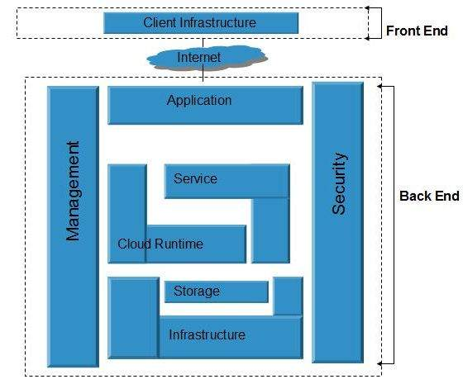

Slide 7
What is Cloud Computing Framework?
The cloud computing framework is also an analytical aid that consultants can use in combination with other intellectuals to help organizations establish a visual roadmap to cloud adoption. In this context, the framework can help organizations in below mentioned points.
● Determine the types of services that can be offered through a cloud.
● Identify the service management capabilities required to enable the chosen delivery model and service, such as metering and billing.
● Recognize the challenges—both immediate and long-term— that should be considered prior to cloud implementation, such as those related to development, deployment, integration, governance, etc.
YouTube:- https://www.youtube.com/watch?v=TH4xLSTY90c

Slide 8
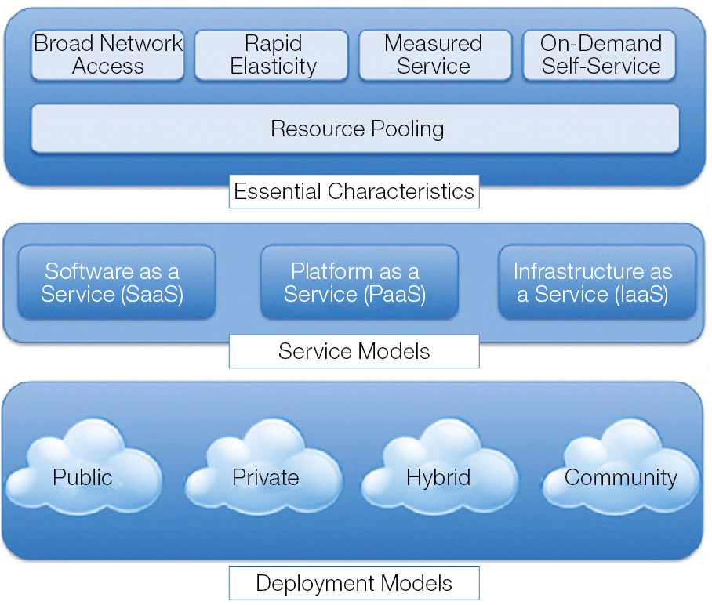

Slide 9
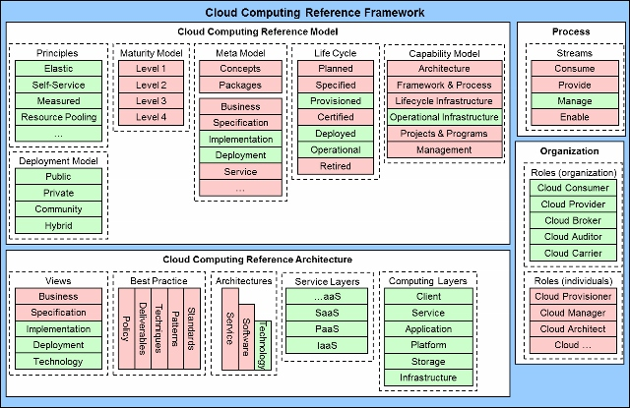
Elements highlighted in green are covered by existing Cloud Computing reference
architectures, models and frameworks. These focus primarily on the operational state of the life cycle, and the implementation and deployment architectures.

Slide 10
What is Cloud Computing Security?
Cloud Computing Security or, more simply, Cloud Security is an evolving sub-domain of computer security, network security, network security, and, more broadly, information security. It refers to a broad set of policies, technologies, and controls deployed to protect data, applications, and the associated infrastructure of cloud computing.
YouTube:- https://www.youtube.com/watch?v=WiFnz5XdaQM

Slide 11
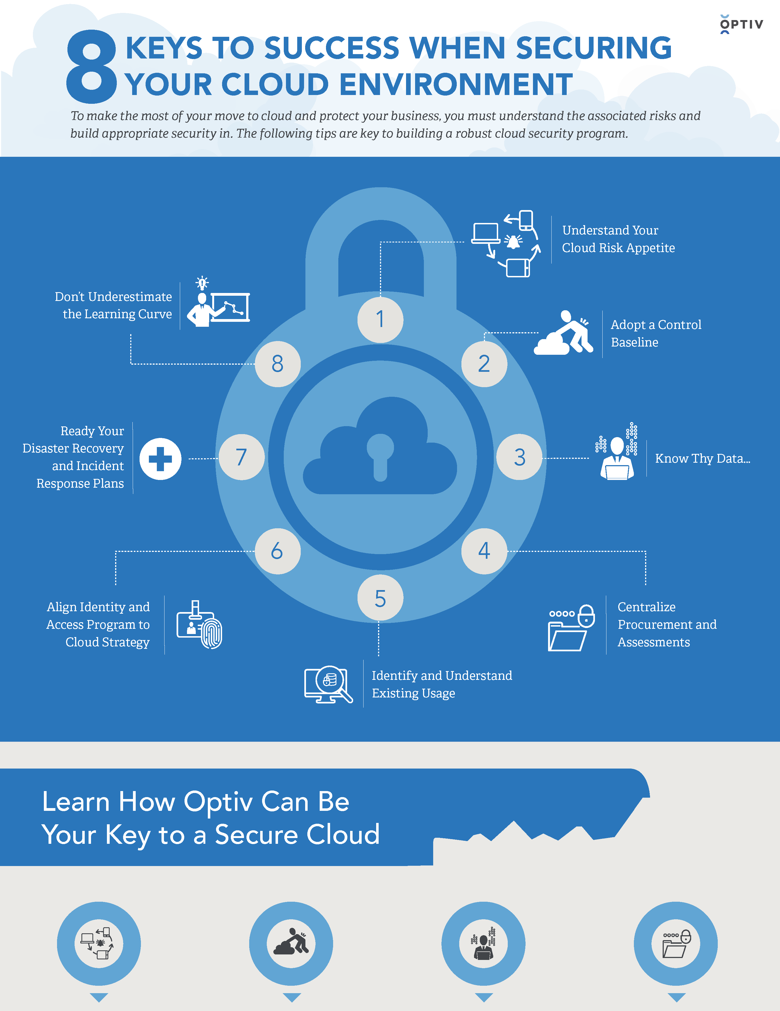

Slide 12
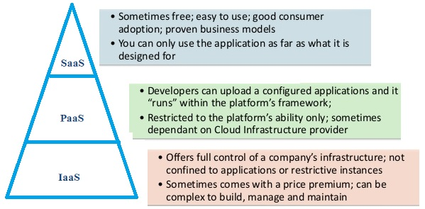

Slide 13
What is CRM?
A CRM system is a business tool that allows you to manage all your customers, partners and prospects information all in one place.
Customer Relationship Management (CRM) is a strategy for managing all your company’s relationships and interactions with your customers and potential customers. It helps you improve your profitability.
CRM enables you to focus on your organisation’s relationships with individual people – whether those are customers,service users, colleagues or suppliers.
YouTube:- https://www.Youtube.com/watch?v=7me7mjvTiTI

Slide 14

What is Salesforce?
Salesforce is the innovative company behind the world’s #1 CRM solution. Salesforce software is cloud-based, so it doesn’t require a team of IT experts to set up or manage — you just log in and start using it.
Salesforce is broken down into several broad categories: Sales Cloud, Service Cloud, Data Cloud (including Jigsaw), Marketing Cloud, Community Cloud (including Chatter), Analytics Cloud, App Cloud,etc.
Salesforce has two different user interfaces: Lightning Experience and Salesforce Classic.
Founder and current Chairman & CEO is Marc Benioff. Headquarter is at The Landmark, San Francisco, California, U.S. Total Revenue for 2016 is US$6.667 million. Total Assests is US$12.77 billion in 2016.
YouTube:- https://www.Youtube.com/watch?v=r6hxqg3PgRQ

Slide 15
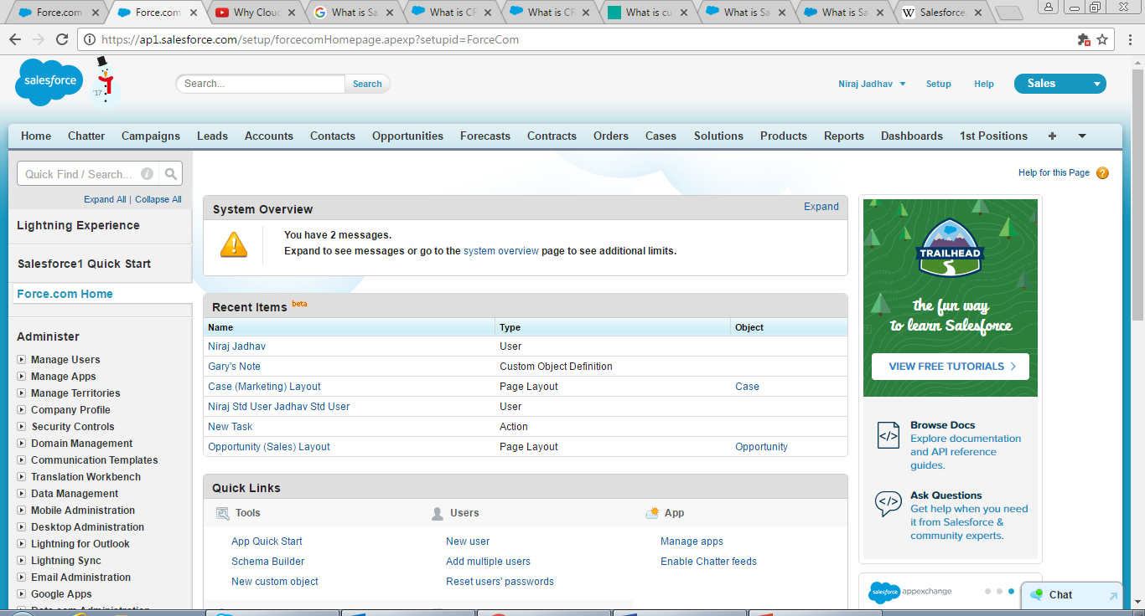
Look and Feel of Salesforce CRM

Slide 16
SALESFORCE RELEASE INFO
USER NAME
SETUP OPTION
APP
GLOBAL SEARCH FOR DATA
QUICK SEARCH FOR SETUP OPTIONS
SALESFORCE TABS

Slide 17
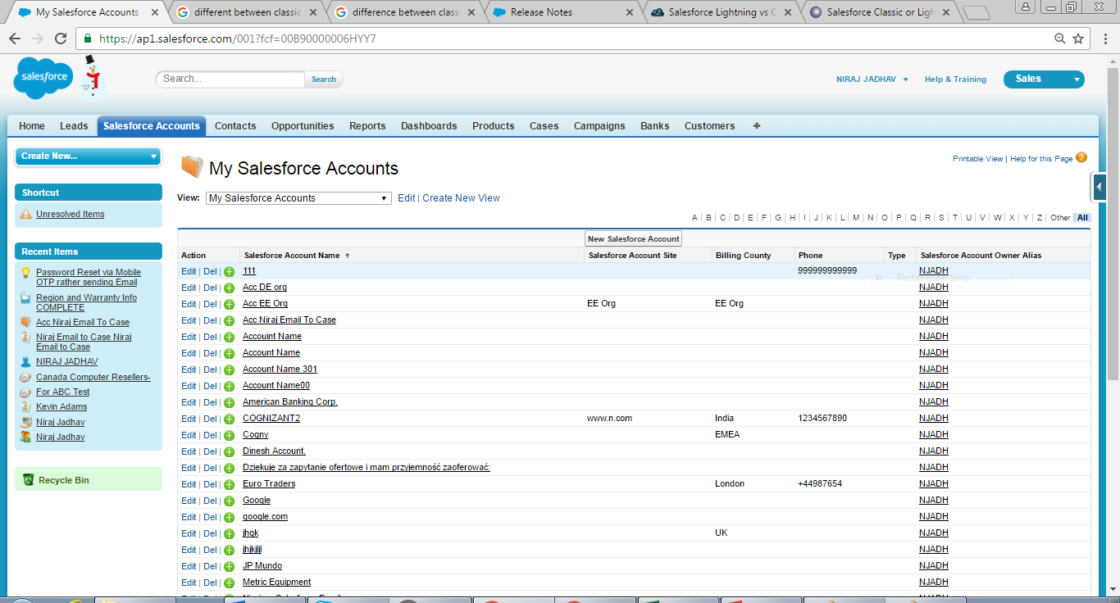
Classic Experience/View

Slide 18
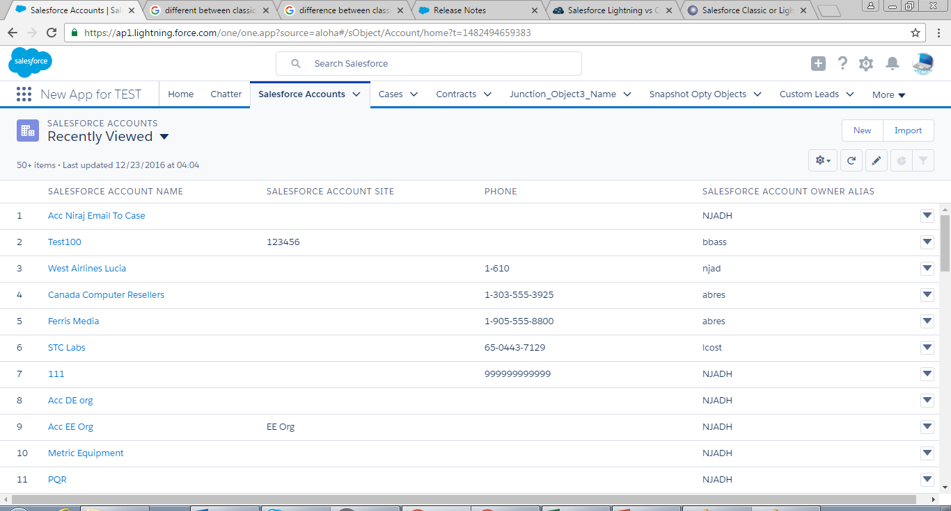
Lightening Experience/View

Slide 19
Exercise:-
Create a New Trial Org from below mentioned link.
Link:
https://www.salesforce.com/form/signup/freetrial-sales.jsp

Slide 20
Declarative or Programmatic Approach?
Broadly speaking, we can achieve our requirement on Salesforce with help of Declarative (Point-And-Click) and/or Programmatic (Apex / Trigger / Visualforce / API) approach.
Declarative (Point-And-Click)/Out of Box approach is a function where you do points and clicks to build your logic.
Programmatic (Apex / Trigger / Visualforce / API) approach is more related to programming/coding in Salesforce.
Declarative (Point-And-Click) approach needs to be your first preference and if it does not fulfill your requirement, then we need to turn to Programmatic (Apex / Trigger / Visualforce / API) approach.

Slide 21
Continued…
MERITS
Declarative (Point-And-Click) | Programmatic (Apex / Trigger / Visualforce / API)
1. It is simpler. 2. No need to do test coding/test class. 3. It is easy to understand, if we know basics of Salesforce. 5. It does not require Programmatic skills. | 1. You have control on function with help of code. 2. It has more flexibility comparative to Declarative (Point-And-Click) as you can mold it with help of codes/logics. 3. You can extend out of the box functionality with help of custom logic/codes, which can be more user friendly, if you know correct coding methodology.
DEMERITS
Declarative (Point-And-Click) | Programmatic (Apex / Trigger / Visualforce / API)
1. It is stringent or can only be workable with certain set of path or rules. 2. At times, it may not applicable to real life scenarios where only Programmatic (Apex / Visualforce / API) is alternate. | 1. You need to be bit knowledgeable in Apex / Visualforce / API average to run your codes. 2. Need to aware about Governor Limits and other interdepended functions/program languages.

Slide 22
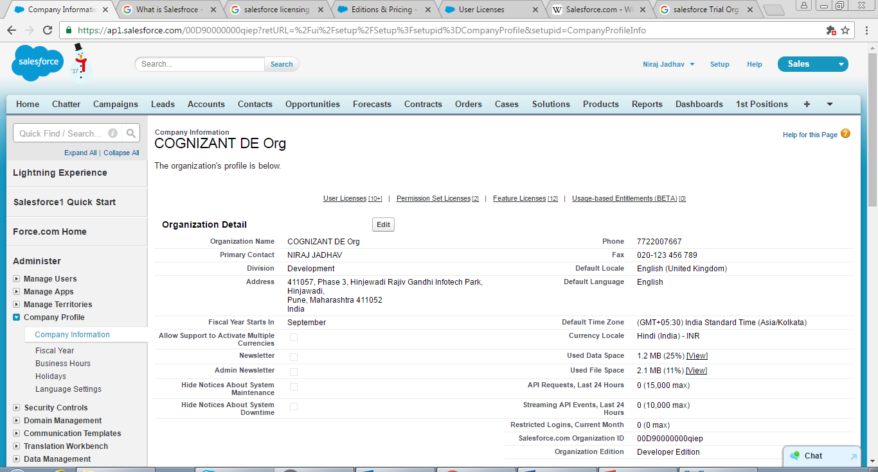
Organization Setup
Click Setup
Click on Company
profile
Click on Company Information

Slide 23
Exercise:-
Setup Organization profile in your Trial Org.

Slide 24
Salesforce Editions
There are different types of editions depending upon cloud functions. Eg. Enterprise/Professional Edition Service/Sales Cloud, etc.
Enterprise Edition or Lightening Enterprise is famous edition where Automation Tool like Workflow Rule, Approval process, etc., Full Profile and Page Layouts, Multiple Sandboxes, etc. are common functions.
Salesforce Help:- https://www.salesforce.com/in/crm/editions-pricing.jsp/
YouTube:- https://www.Youtube.com/watch?v=2mhuHbwOjkY

Slide 25
User Licenses
Salesforce’s different user licenses give users different access to your data. (The license type determines which profiles and permission sets are available to the user.)
To view a list of the active user licenses in your Salesforce org, click Your Name | Setup | Company Profile | Company Information
Salesforce Help:- https://help.salesforce.com/articleView?id=users_understanding_license_types.htm&language=en_US&type=0
YouTube:- https://www.Youtube.com/watch?v=szrscnIlhtc

Slide 26
continued…
Here’s the some of Salesforce user license types:
Salesforce
Full access to standard CRM, custom apps, and AppExchange apps.
Salesforce Platform
Custom apps & core objects (Accounts, Contacts, etc) only; no CRM (no Opportunities or Forecasts).
Knowledge Only User
Salesforce Knowledge app only.
Chatter Free
Access to Chatter for people in your company without a Salesforce license. No additional cost.
Chatter External
Allows your customers to use Chatter groups. No additional cost.
Chatter Only (aka Chatter Plus)
Access to Chatter for people in your company without a Salesforce license PLUS access to accounts & contacts.
Additional cost.
Gold Partner
Partner portal access.

Slide 27
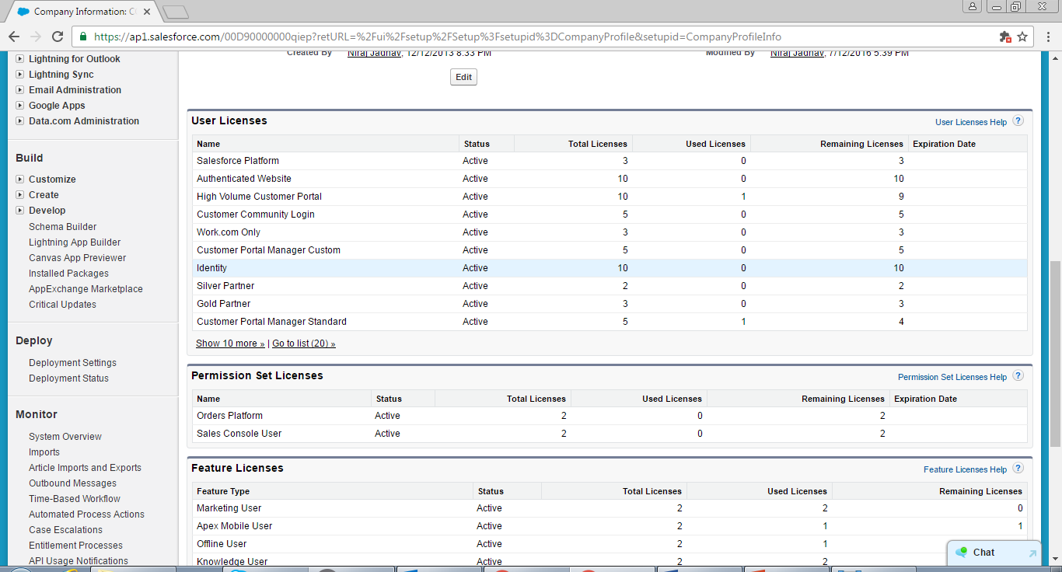

Slide 28
Exercise:-
Check how many User Licenses you have in your Trial Org and discuss about it.
Create New User with different Profiles.

Slide 29
Profiles
A profile is a group/collection of settings and permissions that define what a user can do in salesforce. A profile controls “Object permissions, Field permissions, User permissions, Tab settings, App settings, Apex class access, Visualforce page access, Page layouts, Record Types, Login hours & Login IP ranges.
Salesforce Help:- https://help.salesforce.com/articleView?id=admin_userprofiles.htm&type=0&language=en_US&release=204.15#firstQueryMeta=%5Bobject%2520Object%5D
YouTube:- https://www.Youtube.com/watch?v=eyFCgOWbWmc

Slide 30
continued…
Standard Profile:
Standard profiles are created by default from Salesforce. Object-level and user permissions cannot be changed on these profiles. Standard profiles cannot be deleted.
Custom Profile:
Custom profiles are created by System Administrator and can be fully customized. Custom profiles can be deleted.
System Administrator (Standard Profile or Custom Profile Eg. ‘UK - System Administrator’) have all of administrative accesses or ‘God Accesses’ to make necessary changes in Salesforce.

Slide 31
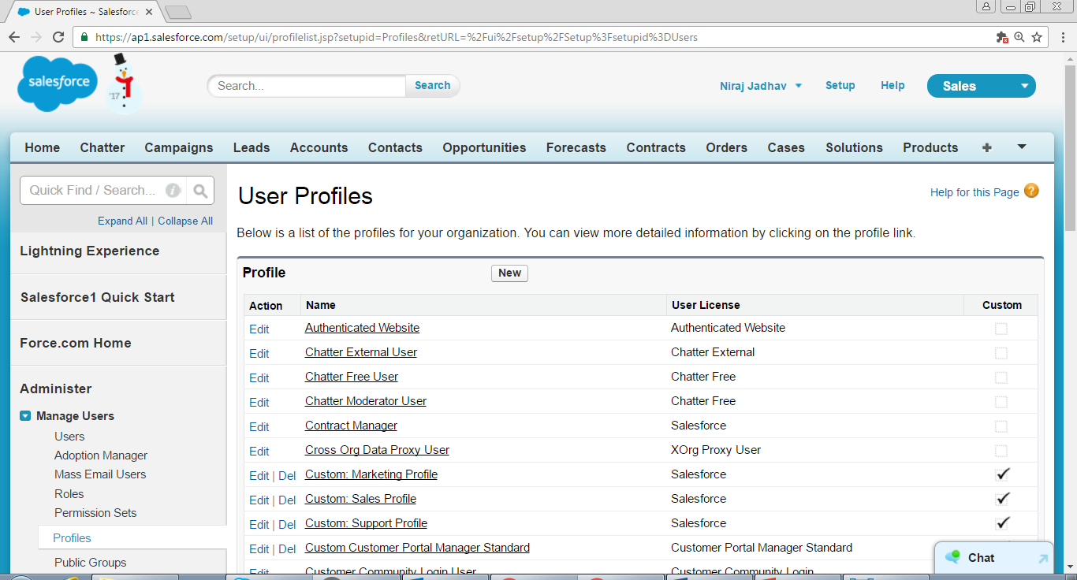
Task for follow up call tomorrow
Standard Profile
Custom Profile

Slide 32
Exercise:-
Check how many Standard Profiles you have and create some Custom Profiles.

Slide 33
Roles/Role Hierarchy
Role/Role Hierarchy represents a level of data access that a user or group of users needs. Users assigned to a particular roles to get access the data of all the users who fall directly below them in the hierarchy. The role hierarchy enables these behaviors precisely to data access or data share.
Salesforce Help:- https://help.salesforce.com/articleView?id=admin_roles.htm&type=0&language=en_US&release=204.17
YouTube:- https://www.youtube.com/watch?v=5blx1vs9TCs

Slide 34
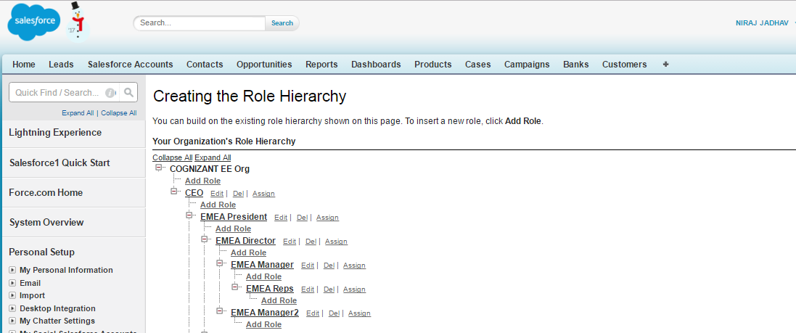

Slide 35
Exercise:-
Setup correct Role Hierarchies.

Slide 36
Permission Set
A Permission Set is a collection of add-on settings and add-on permissions that give users access to various tools and functions to complete this duty.
Example: Standard Profile – Standard User does not have “Create Report Folders” permission, hence, we can create Permission Set and grant “Create Report Folders” permission to user post assigning Permission Set to him/her.
Salesforce Help:- https://help.salesforce.com/articleView?err=1&id=perm_sets_overview.htm&siteLang=en_US&type=0
YouTube:- https://www.Youtube.com/watch?v=gevC2anVZDQ

Slide 37
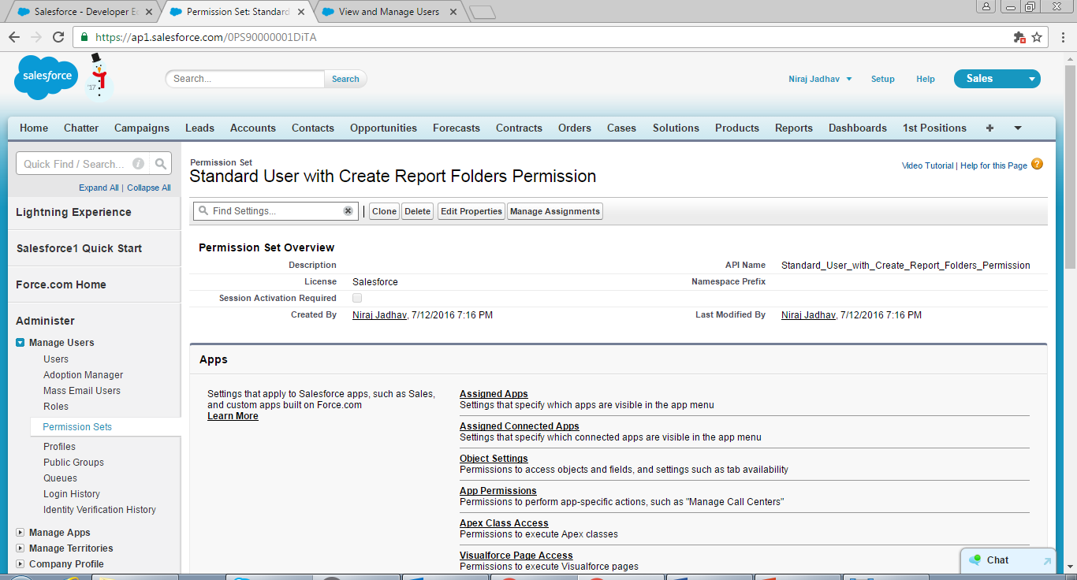

Slide 38
Organization Wide Defaults
Organization-Wide Defaults or OWDs are the baseline security for your Salesforce instance. Organizational Wide Defaults are used to check status of access/es depending on Default Internal/External Access.
Grant Access using Hierarchies:- Level of access on records depending upon profile permission and on basis of Role Hierarchy. i.e. Supervisor can see/edit data of Sub-Ordinate(if Supervisor's profile allows it), however, Sub-Ordinate will not be able do it, if it is Private. We can only modify Grant Access using Hierarchies on Custom Object because on Standard Object it is by default checked.
Salesforce Help:- https://help.salesforce.com/articleView?id=security_sharing_owd_users.htm&language=en_US&type=0
YouTube:- https://www.youtube.com/watch?v=tPgWtulb8s0

Slide 39
Continued…
There are 6 levels of access that can be set:
1. Public Read/Only:- The user can only read the records depending on basis of profile permission.
2. Public Read/Write:- The user can have the ability to search records, reports, and records, add related records, edit details of the record, can delete the record, etc if profile permission allows it.
3. Public Read/Write/Transfer:- This option is available for Leads and Cases where all users can view, edit, transfer, and report on all cases and lead records, if their profile allows it.
4. No Access/View Only/Use:- This option is available only for Price Book.
i. Use:- It is default access for Price Book and allows the users to access the Price Book information and can use that Price Book with Opportunities with Products.
ii. View Only:- It allows the user to access the Price Book information, however, cannot use it in Opportunities with Products.
iii. No Access:- As title defines, it restricts the users to access Price Book information and prices.
5. Controlled by Parents:- The level of access, which is there on Parent Object in Master Details Relationship will be inherit to Child Object (Details Object) by default as per profile permission.
6. Private:- This option only enable accesses on basis of Role Hierarchy (from Up to Down - i.e. Supervisor can see/edit data of Sub-Ordinate(if Supervisor's profile allows it), however, Sub-Ordinate will not be able do it.) Still, if we want to share record then we need to create Sharing Rule.

Slide 40
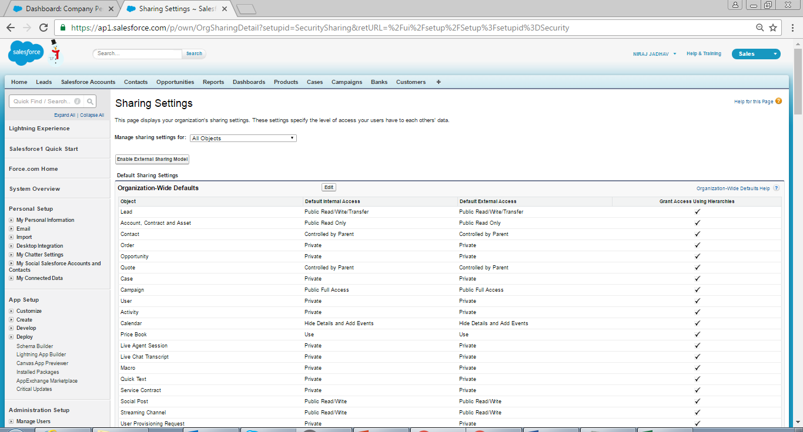

Slide 41
Exercise:-
Check your Organization Wide Default and check its behavior post login as different User, who is below particular Role Hierarchy.

Slide 42
Users
User can access those functions, which are there or granted on Profile and/or Permission Set.
User will login to Salesforce to fulfill his duties such as creation of Lead, Account, Contact, etc., follow up with client/s, sending email/s, etc.
Salesforce Help:- https://help.salesforce.com/articleView?err=1&id=admin_users.htm&siteLang=en_US&type=0
YouTube:- https://www.Youtube.com/watch?v=xRkLltVXRkM

Slide 43
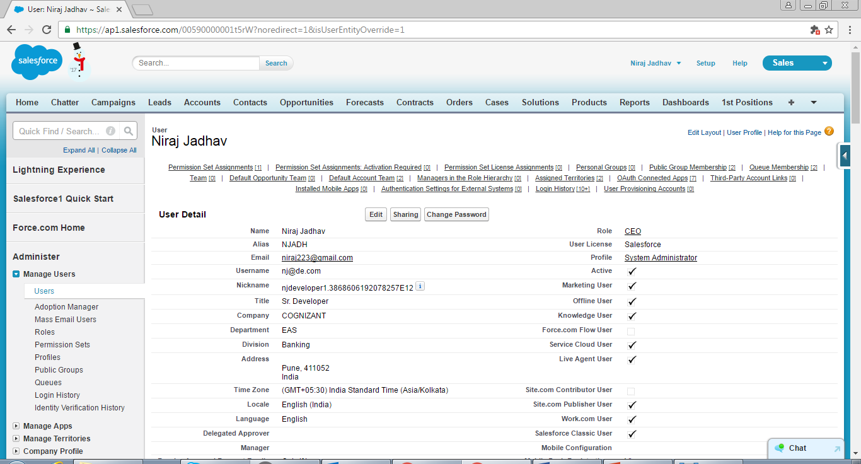
Ram will click here to convert this Lead to an Account, Contact, Opportunity (optional).

Slide 44
Exercise:-
Create dummy User/s and try to assign Profile (Standard & Custom Profile).

Slide 45
App
An App is nothing but a container which contains a logo, ordered set of tabs, permissions to profile, etc to fulfill particular function. It may be Console App or Non-Console (Normal) App. We cannot delete Standard App however, we can create and delete Custom App, if required.
Example: Sales App contains Home, Chatter, Campaigns, Leads, Accounts, Contacts, Opportunities, Forecasts
Salesforce Help:- https://help.salesforce.com/articleView?id=dev_tabsets.htm&type=0&language=en_US&release=204.16#firstQueryMeta=%5Bobject%2520Object%5D
YouTube:- https://www.Youtube.com/watch?v=DC58hjb_MeA

Slide 46
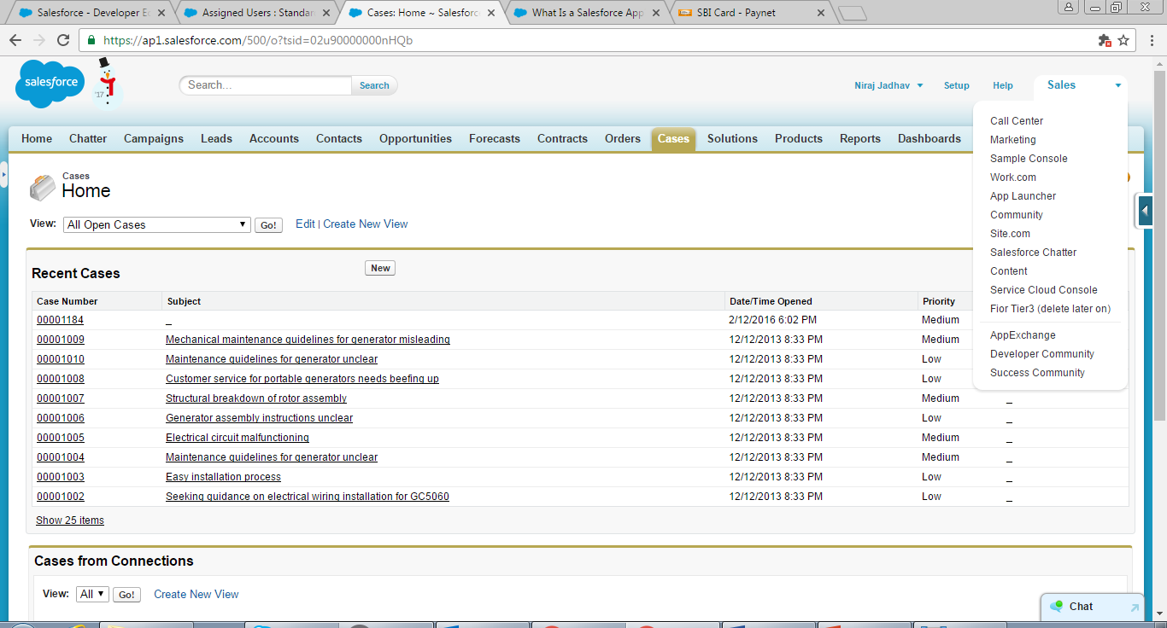
Selected App
Available Tabs in Selected App (Sales App)

Slide 47
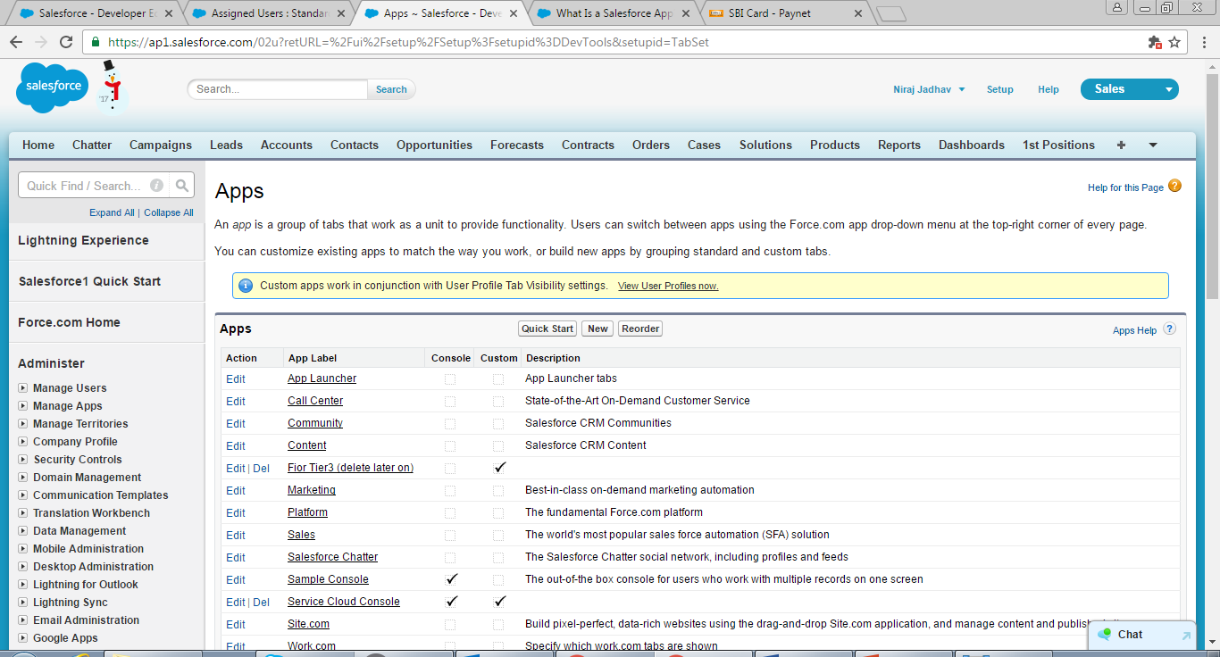

Slide 48
Exercise:-
Create 2 New Apps in your Trial Org.
Normal App, which will contain Accounts, Contact, Opportunities, Leads, and Campaigns only.
Console App, which will contain Cases, Leads, Account, and Contacts only.

Slide 49
Objects
In a relational database, data is stored in tables. Each table comprises a number of columns of a particular data type, such as text, number, or date. Information is stored in rows of the table. Tables can be related to other tables, using primary and foreign keys.
Salesforce Object comprises a number of fields, which correspond to columns in a database. Data is stored in records of the object, which correspond to rows in a database. There are two types of Objects in Salesforce.
Standard Objects—These are objects included with Salesforce, by default, for example the objects used to store data in standard tabs such as Accounts, Contacts, Opportunities, etc.
Custom Objects—These are new objects you create to store information unique to your organization. Custom objects extend the functionality that standard objects provide. For example, to track data regarding Invoice, you can create Custom Objects called Invoices. Other examples are Employee, Bank, Order, etc. We can create Custom Objects from Setup | Create | Objects
Salesforce Help:- https://help.salesforce.com/articleView?id=co_overview.htm&type=0&language=en_US
YouTude:- https://www.Youtube.com/watch?v=qgw_uJMFY8M

Slide 50
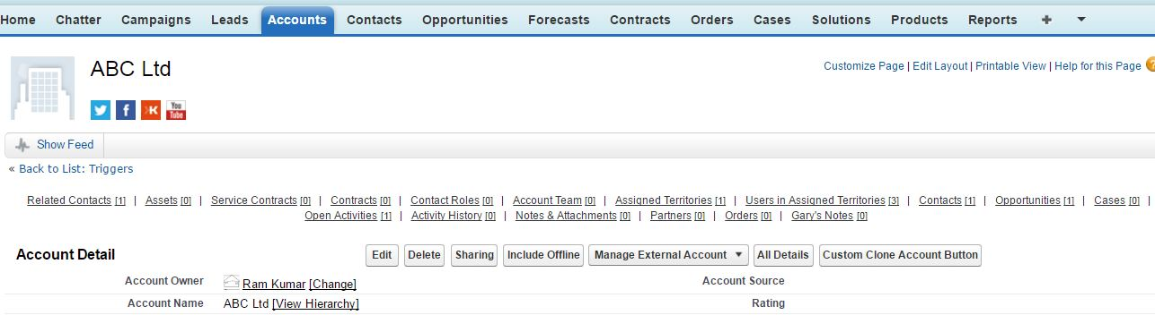
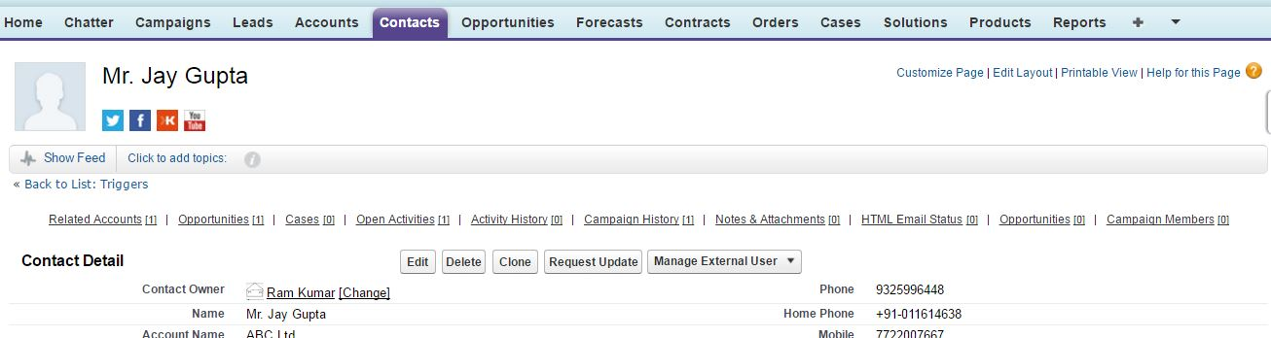
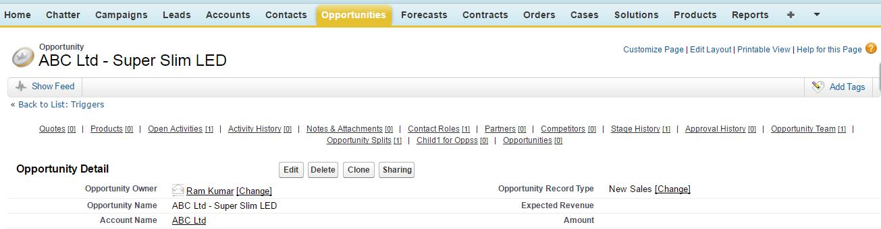
Standard Object - Account
Standard Object - Contact
Standard Object - Opportunity

Slide 51
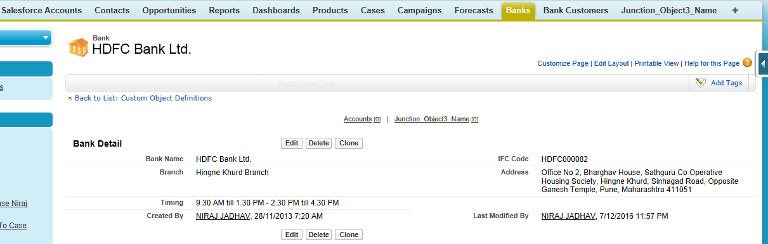
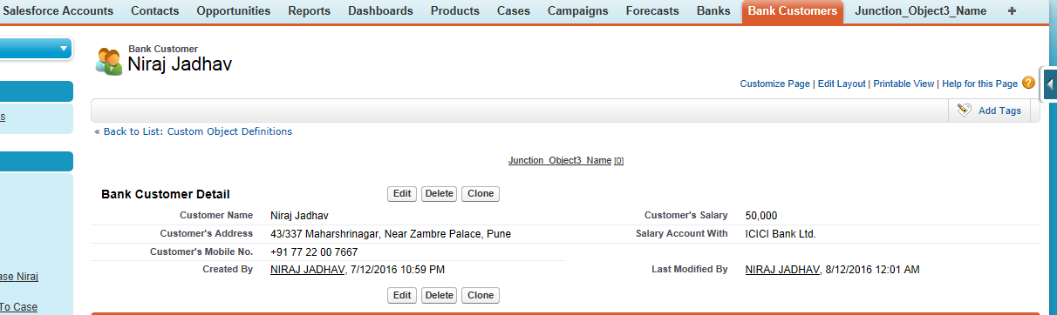
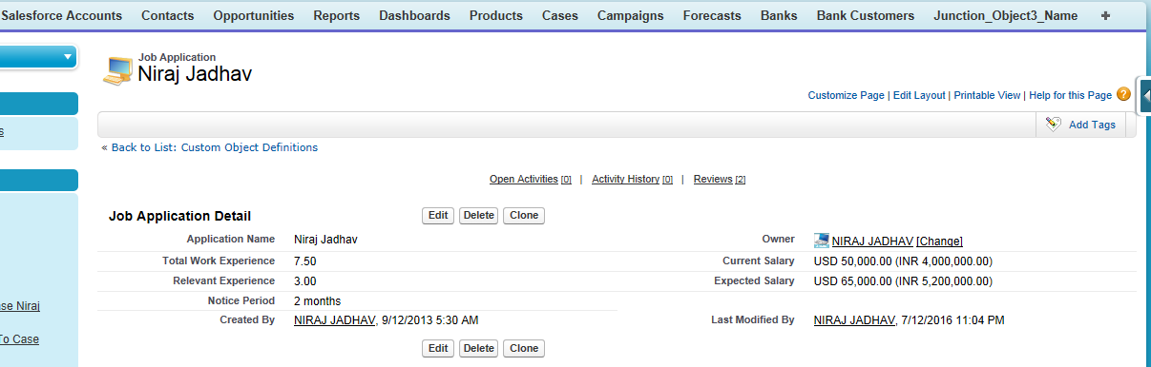
Custom Object - Banks
Custom Object – Bank Customers
Custom Object – Job Applications

Slide 52
Exercise:-
Create 4 Custom Objects. Example: Banks, Customers, Bank Customer, Invoice, etc in your Org.

Slide 53
Relationship
A relationship is any association, linkage, or connection between the
entities of interest to the business; it is a two-directional, significant
association between two entities, or between an entity and itself.
Salesforce Help:- https://help.salesforce.com/articleView?id=overview_of_custom_object_relationships.htm&type=0&language=en_US&release=204.16
YouTube:- https://www.Youtube.com/watch?v=32ebJH5HK7I

Slide 54
Type of Relationships
Lookup (1:n): It links two objects together. Lookup relationships are similar to Master-Detail relationships, except they do not support Sharing or Roll-Up Summary fields. In this type of relationship, you can link two objects together, but has no effect on deletion or security. Unlike Master-Detail fields, lookup fields are not automatically required. When you define a Lookup relationship,
data from one object can appear as a custom Related List on Page Layouts for the other Object. We can also create Lookup relationship to same Object, therefore, it become Self Lookup Relationship (E.g. Account : Accounts).
Master-detail (1:n): Closely links Objects together such that the Master Record controls certain behaviors of the Detail and Sub-detail record. For example, you can define a two-object Master-Detail Relationship, such as Account—Expense Report, that extends the relationship to Sub-detail records, such as Account—Expense Report—Expense Line Item. You can then perform operations across the Master—Detail—Sub-detail relationship. It is also a relationship in which the master object controls certain behaviors of the Detail object, which we will explain in detail in training. You can define Master-Detail relationships between Custom Objects or between a Custom Object and a Standard Object. However, the Standard Object cannot be on the Detail side of a relationship with a Custom Object. In addition, you cannot create a Master-Detail relationship in which the User or Lead objects are the Master.
Behaviors of Master-Detail relationships:
Deleting a Detail record moves it to the Recycle Bin and leaves the Master record intact; deleting a Master record also deletes related Detail and Sub-detail records. Undeleting a Detail record restores it, and undeleting a Master record also undeletes related Detail and Sub-detail records. However, if you delete a Detail record and later, separately, delete its master record, you cannot undelete the Detail record, as it no longer has a Master record to relate to.
There are few more behaviors of Master-Details relationships, which we will explain in brief.

Slide 55
Continued…
Many-to-Many (n:n) : You can use Master-Detail relationships to model Many-to-Many relationships between
any two objects. A Many-to-Many relationship allows each record of one object to be linked to multiple
records from another object and vice versa. For example, you may have a custom object called “Bank” that
relates to Customers object such that a Bank could be related to multiple Customer and Customer could also
be related to multiple Banks.
External lookup: An external lookup relationship links a Child Standard, Custom, or External Object to a Parent
External object. When you create an External Lookup relationship field, the standard External ID field on the
Parent External Object is matched against the values of the child’s External lookup relationship field. External object
field values come from an External Data Source.
Indirect lookup: An Indirect Lookup relationship links a Child External object to a Parent Standard or Custom Object.
When you create an Indirect Lookup relationship field on an External Object, you specify the Parent Object field
and the Child Object field to match and associate records in the relationship.
Hierarchical (1:n): A Special Lookup relationship available for only the User Object. It lets Users use a Lookup field to
associate one user with another that does not directly or indirectly refer to itself.
For example, you can create a Custom Hierarchical Relationship field to store each User's direct Manager.

Slide 56
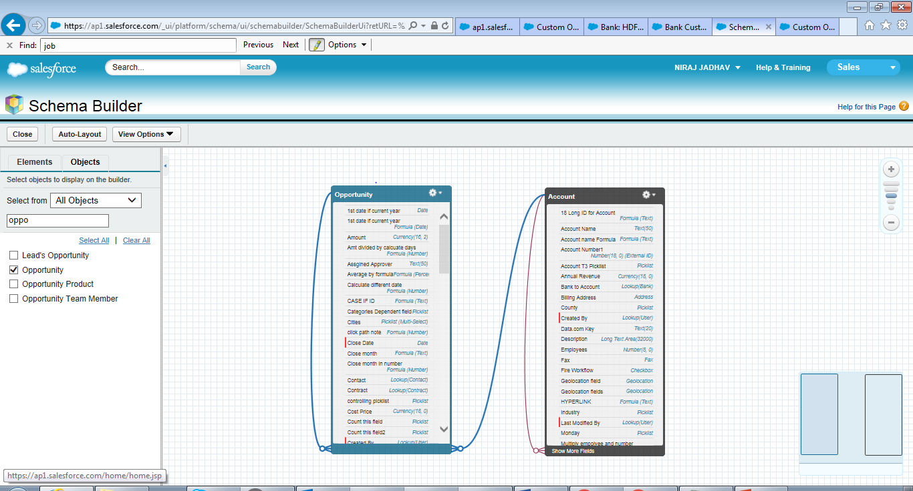
Lookup Relationship (1:n): Account (parent) & Opportunity.

Slide 57
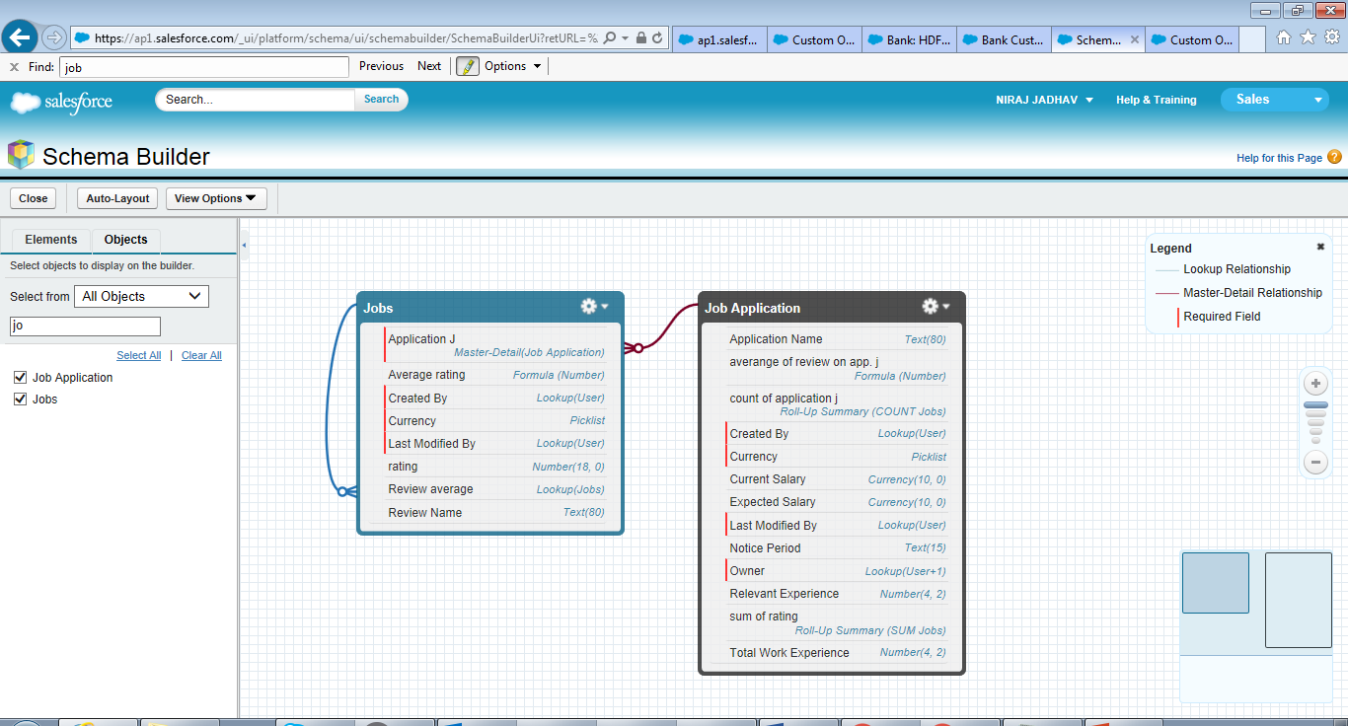
Master Details (1:n): Job Application (parent)

Slide 58
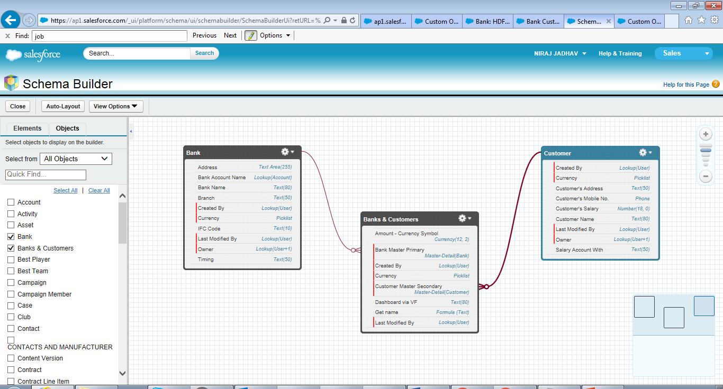
Master Details (n:n): Many-to-Many or Junction Object
Master 1 – Bank (parent)
Master 2 - Customer
Detail - Junction Object
Banks & Customer

Slide 59
Exercise:-
Create 2 Lookup Relationship between One Standard Object and One Custom Object and vice versa.
Create 1 Self Lookup Relationship on Custom Object.
Create Master Details Relationship (1:n) to Custom Object.
Create 1 Many-to-Many : Master Details Relationship (n:n) or Junction Object between Standard and Custom Object.
Create 1 Many-to-Many : Master Details Relationship (n:n) or Junction Object between Custom Object and Standard Object.

Slide 60
Schema Builder
The Element tab’s drag-and-drop interface lets you easily add a Custom Object or New Field, and saves the layout of your schema any time you move an Object. Schema Builder provides details such as the field values, required fields, and how objects are related by displaying lookup and master-detail relationships.
Salesforce Help:- https://help.salesforce.com/articleView?id=schema_builder.htm&type=0
YouTube:- https://www.youtube.com/watch?v=Q8JA6syQ90A

Slide 61
Lookup Relationship

Slide 62
Master Detail Relationship

Slide 63
Exercise:-
Create New Custom Object from Schema Builder and add several fields in it.

Slide 64
Fields
A field is an area of particular Data Type in a fixed or known location in a unit of data such as a record.
Fields display in a variety of places in the Salesforce user interface, including Page Layouts, Related Lists, Search Layouts, List Views, and Reports. For the majority of the fields, you can within Custom Formula fields, Visualforce Pages, Custom Links, and Custom Buttons.
There are 2 types of fields Standard Fields and Custom Fields. We cannot delete Standard Fields.
You can create Custom Fields from Setup | Customize | Object Name | Fields and click on ‘New’ under Custom Fields & Relationships or in case of Custom Object, Setup | Create | Object | Object Name | Fields and click on ‘New’ under Custom Fields & Relationships.
Nature of fields depends upon its Data Type. Example:- Number, Email, Text, Long Text, Checkbox, etc
Salesforce Help:- https://help.salesforce.com/articleView?id=adding_fields.htm&type=0&language=en_US&release=204.16#firstQueryMeta=%5Bobject%2520Object%5D
YouTube:- https://www.Youtube.com/watch?v=W_rqRwiy8UQ

Slide 65
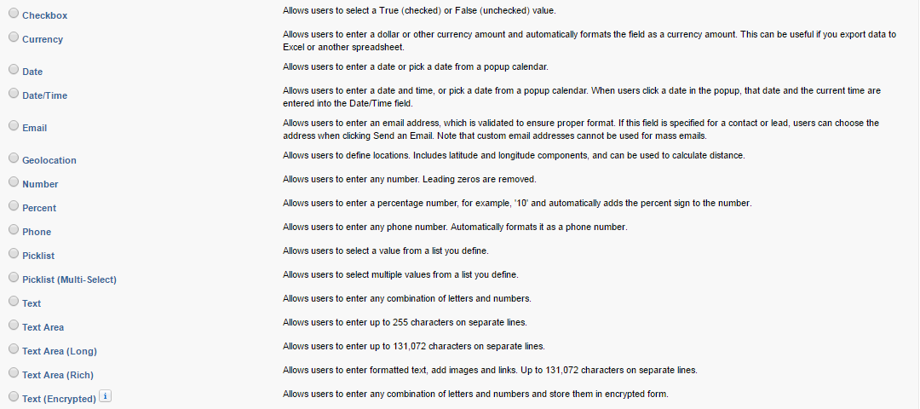
Continued…
Different Data Types of Custom Fields

Slide 66
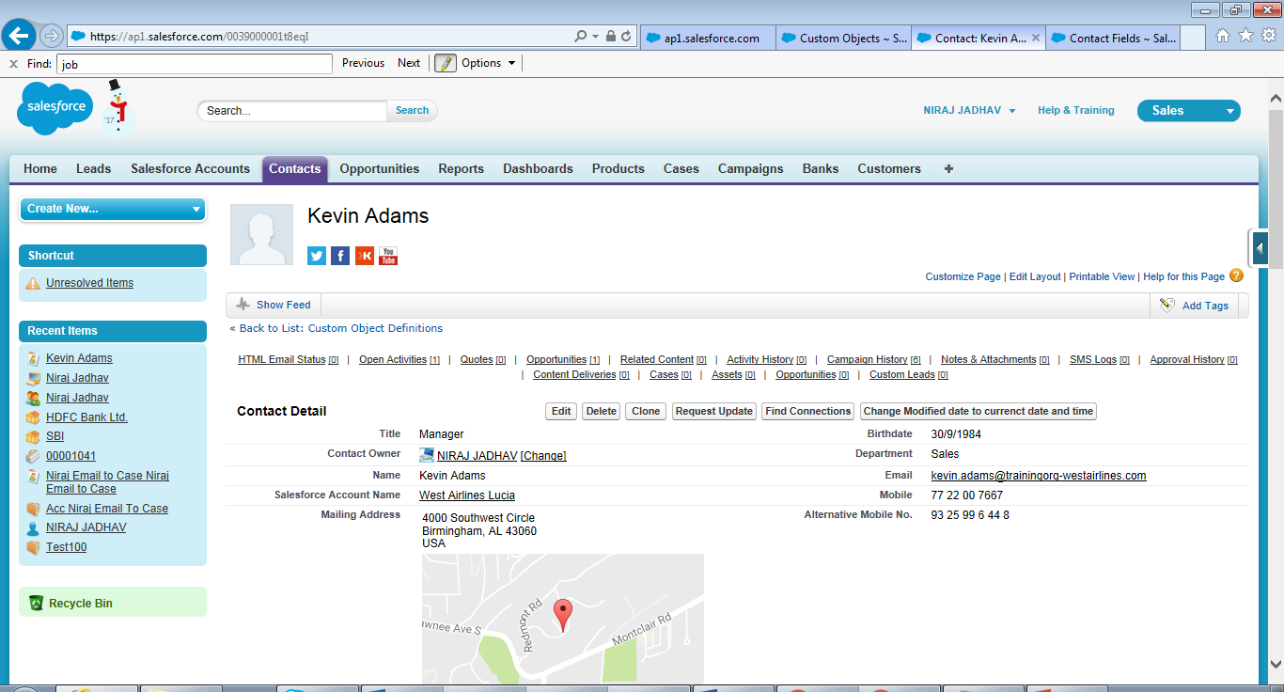
Custom Field with Phone (data type)
(rest all fields are Standard Fields)

Slide 67
Exercise:-
Create several Custom Fields with correct Data Type.

Slide 68
Custom Formula Field
Formula field is a field where we can use our logic to display respective values depending upon some calculations or some result. E.g. What is 10% of Opportunity Amount, etc.
Salesforce Help:- https://help.salesforce.com/articleView?id=customize_formulas.htm&type=0&language=en_US&release=204.16#firstQueryMeta=%5Bobject%2520Object%5D
YouTube:- https://www.Youtube.com/watch?v=bn3Y8jGFbwE

Slide 69
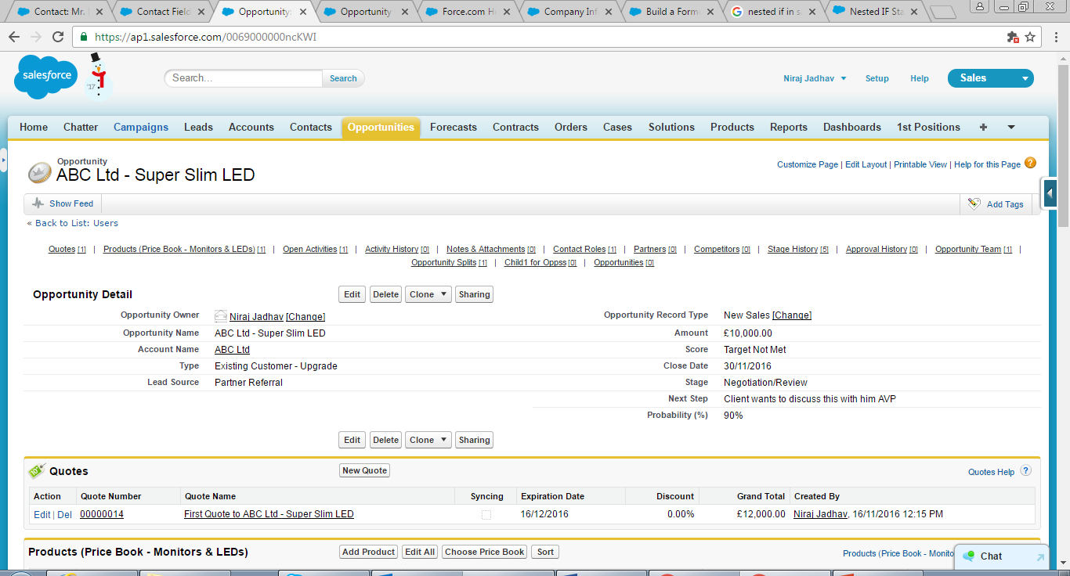
Sample Formula:-
IF( Amount <49999, "Target Not Met", IF( Amount <79999, "Target Met", "Above Target"))
Custom Formula Field
Product in related list

Slide 70
Exercise:-
Create several Custom Formula Field on different objects.

Slide 71
Controlling & Dependent Picklist
As we have seen that Custom Fields do have different types of data type. E.g. Picklist, Number, Checkbox, etc. We do have functionality of Controlling and Dependent Picklist as well.
Dependent/Controlling Picklist refer to a functionality where Child Picklist values is linked with Parent Picklist values. E.g. India does have Mumbai, Pune, Delhi as cities and not New York as it comes under USA. Similarly, USA does have New York, Washington Dc, Los Angeles, etc. Therefore Parent Picklist is called Controlling Picklist and Child Picklist is called as Dependent Picklist.
Salesforce Help:- https://help.salesforce.com/articleView?id=fields_about_dependent_fields.htm&type=0&language=en_US&release=204.16#firstQueryMeta=%5Bobject%2520Object%5D
YouTube:- https://www.Youtube.com/watch?v=AAjxF-zTC5g

Slide 72
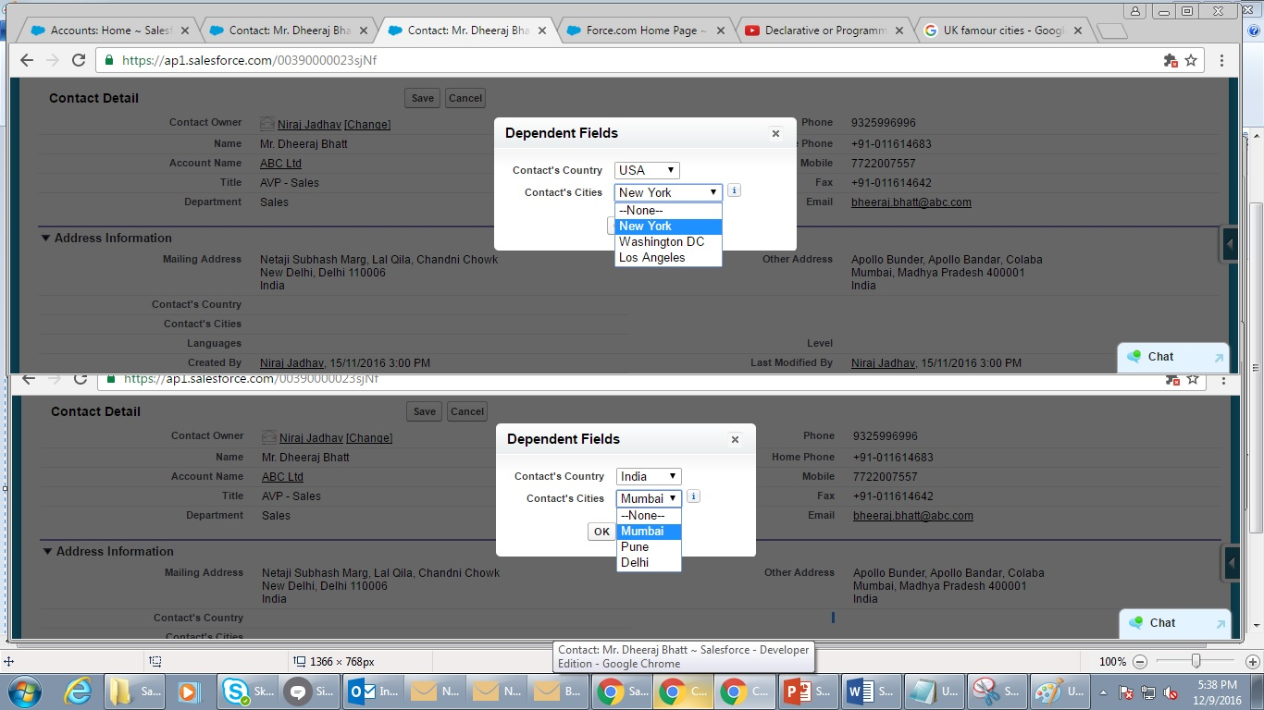

Slide 73
Exercise:-
Create some Controlling and Dependent Picklists.

Slide 74
Rollup Summary Fields
Formula fields calculate values using fields within a single record, roll-up summary fields calculate values from a set of related records, such as those in a related list. You can create roll-up summary fields that automatically display a value on a master record based on the values of records in a detail record. These detail records must be directly related to the Master through a Master-Detail Relationship.
The Roll up Summary field is basically of 4 types:
Count
Sum
Min
Max
Salesforce Help:- https://help.salesforce.com/articleView?id=fields_about_roll_up_summary_fields.htm&type=0&language=en_US&release=204.16#firstQueryMeta=%5Bobject%2520Object%5D
YouTube:- https://www.youtube.com/watch?v=QtQXQpBTPvc

Slide 75
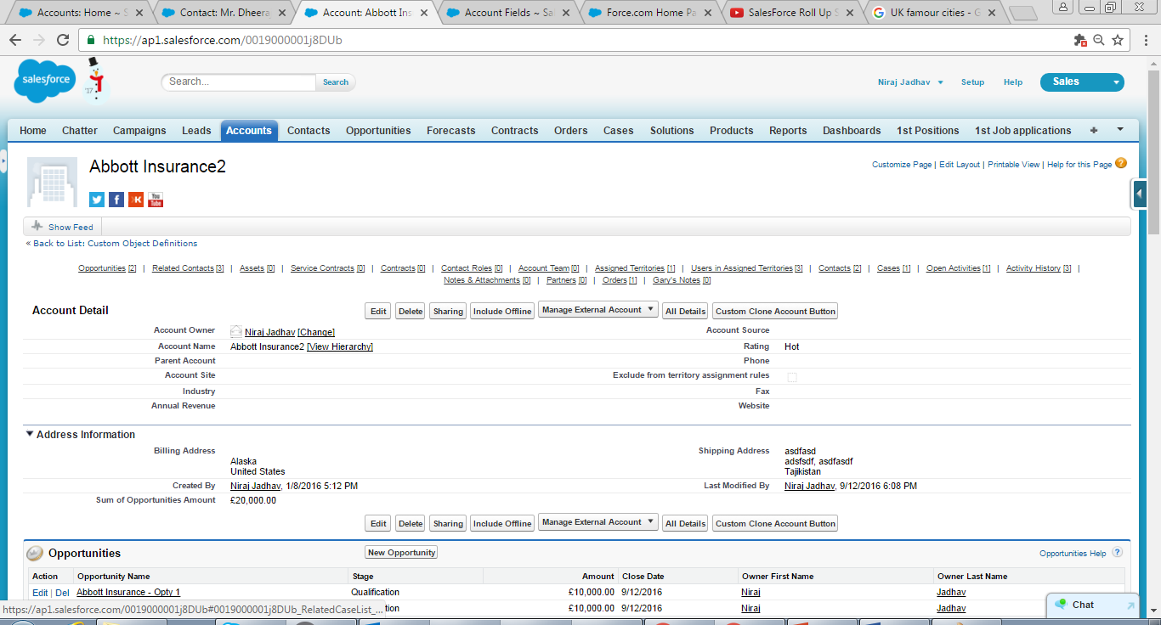

Slide 76
Exercise:-
Create Roll Up Summary on Account.
Can you create Roll Up Summary on Contact? If not, why?

Slide 77
Field Tracking/Field History Tracking
It is a functionality where you can get information of Old and New values under History Related List once Field Tracking/Field History Tracking is enabled. Salesforce preserves it for up to 18 months. You may also run report on it.
Salesforce Help:-
https://help.salesforce.com/articleView?id=tracking_field_history.htm&language=en&type=0
YouTube:- https://www.youtube.com/watch?v=VpVLYyqiUfg

Slide 78
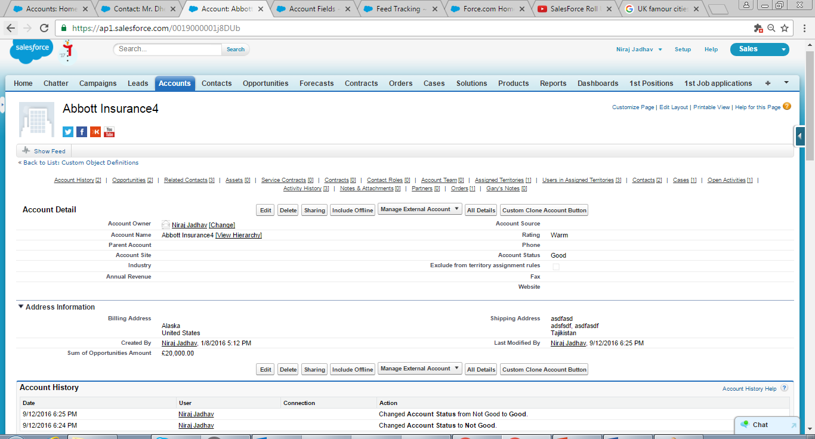

Slide 79
Exercise:-
Enable some field for Field History Tracking function on Account, Contact, etc.

Slide 80
Business Processes (Sales, Support, Lead, or Solution Process)
Business Process offers different subsets of picklist values to different users depending on their Profile for the Lead Object - Lead Status, Case Object - Case Status, Opportunity Object - Opportunity Stage and Solution Object - Solution Status fields. Hence, you can categorize your Opportunity Stage, Lead Status, Case Status, and Solution Status picklist values into lists called Sales Processes, Lead Processes, Support Processes, or Solution Processes. Then, associate each Business Process with one or more record types and make that record type available to users based on their profile. Basically, Business Process is lifecycle process of Lead, Case, Opportunity, & Solution records.
Salesforce Help:- https://help.salesforce.com/articleView?id=customize_processes.htm&type=0&language=en_US&release=204.16
YouTube:- https://www.youtube.com/watch?v=Vh6iM9LSTvY

Slide 81
Exercise:-
Create Business Processes for Lead, Cases, and Opportunities.

Slide 82
Page Layouts
Page Layouts is the combination of Custom Button, Fields, Custom Links, Related Lists, etc on an object detail or edit page. It is used to organize User Interface pages for user/s i.e. which fields, related lists, Custom links, etc user/s can sees. We can also decorate page layouts within limited scope. Page Layout may or may not linked with Record Type depending upon your business need.
Salesforce Help:-
https://help.salesforce.com/articleView?id=customize_layout.htm&type=0
YouTube:- https://www.youtube.com/watch?v=DGva7oJxztw

Slide 83
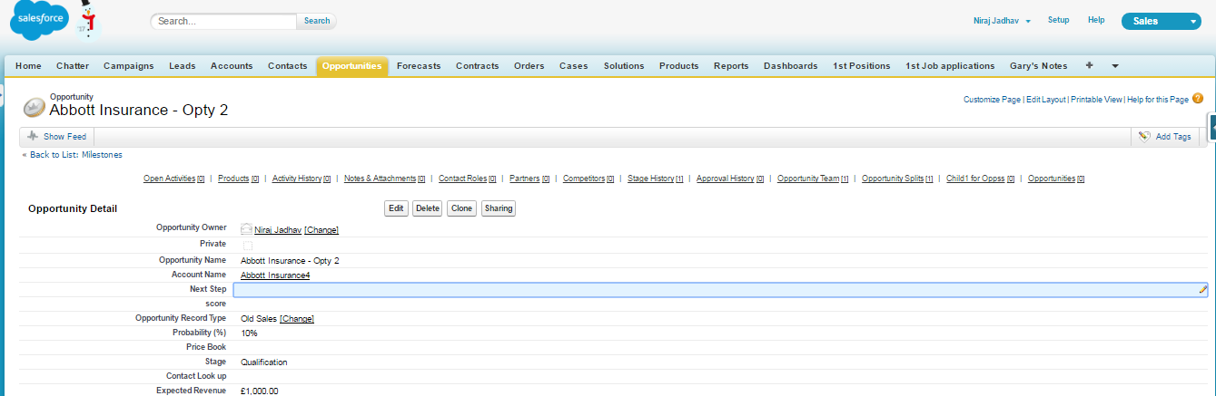
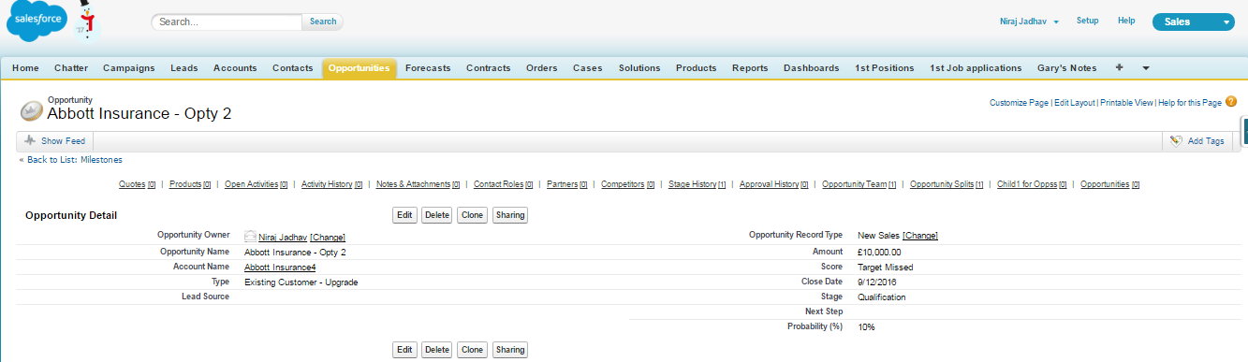
Record associated Page Layout 1
Record associated Page Layout 2

Slide 84
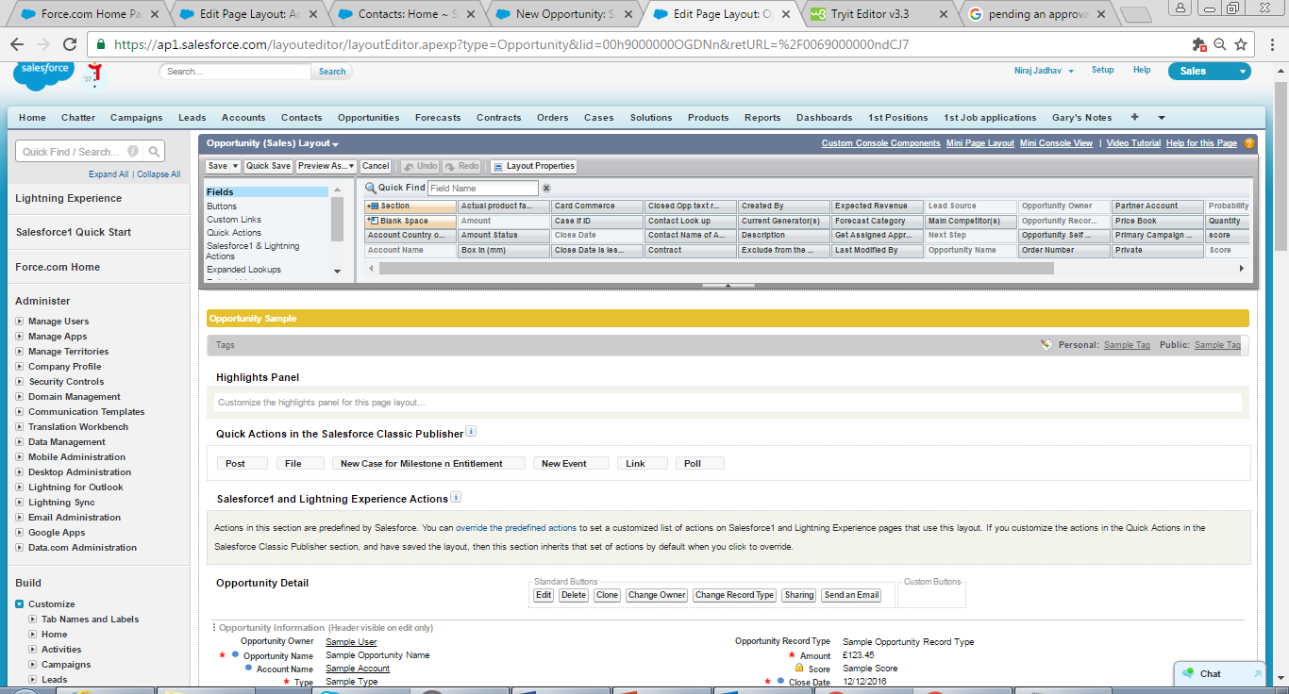

Slide 85
Exercise:-
Create 2 Page Layouts and decorate it.

Slide 86
Record Type
Record types allow you to associate different business processes and subset of pick list values to different users based on their user profile. They are used to drive which page layouts users see when viewing records, based on their user profile.
Salesforce Help:- https://help.salesforce.com/articleView?id=creating_record_types.htm&type=0&language=en_US&release=204.16
YouTube:- https://www.youtube.com/watch?v=JUFq1do07fA

Slide 87
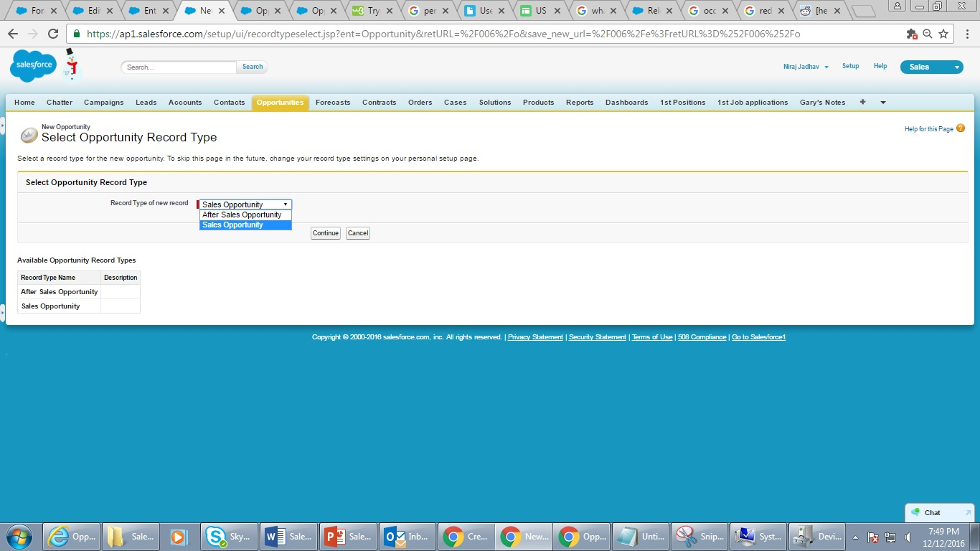
Selection of Record Type

Slide 88
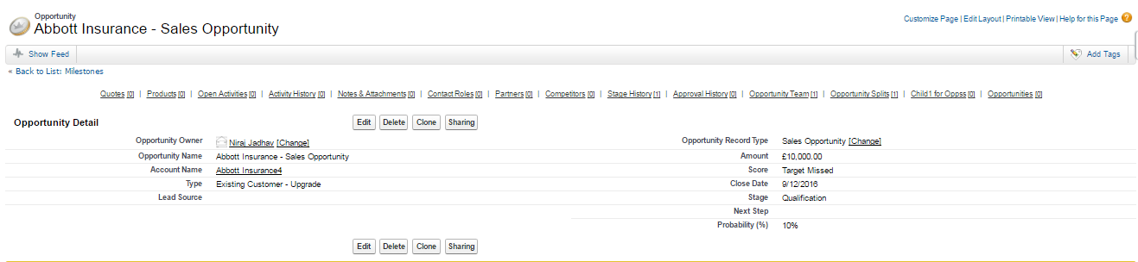
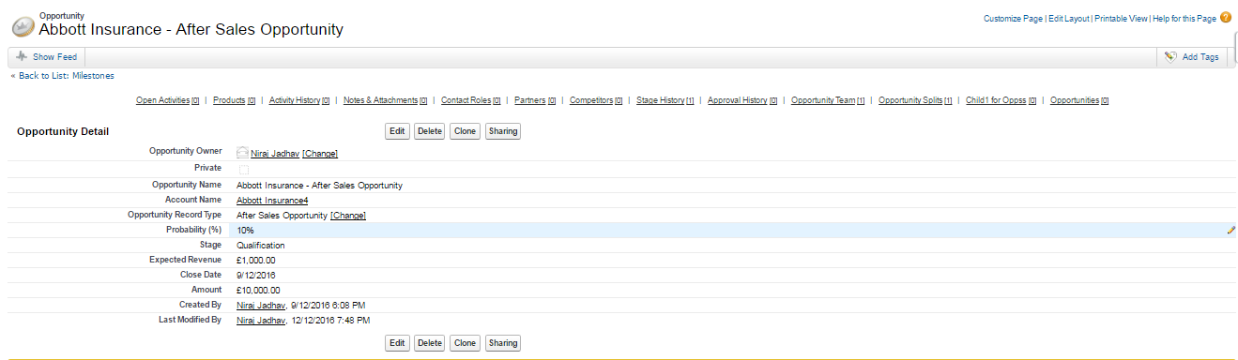

Slide 89
Exercise:-
Create 2 Record Types and assign respective Page Layouts.

Slide 90
List View
List View allows you to see a filtered list of records, such as contacts, accounts, custom objects, etc. A list view is used to quickly segment, and then take action on related records.
Salesforce Help:- https://help.salesforce.com/articleView?id=customviews_parent.htm&type=0&language=en_US&release=204.17
YouTube:- https://www.youtube.com/watch?v=z4Ri4YpaPfc

Slide 91
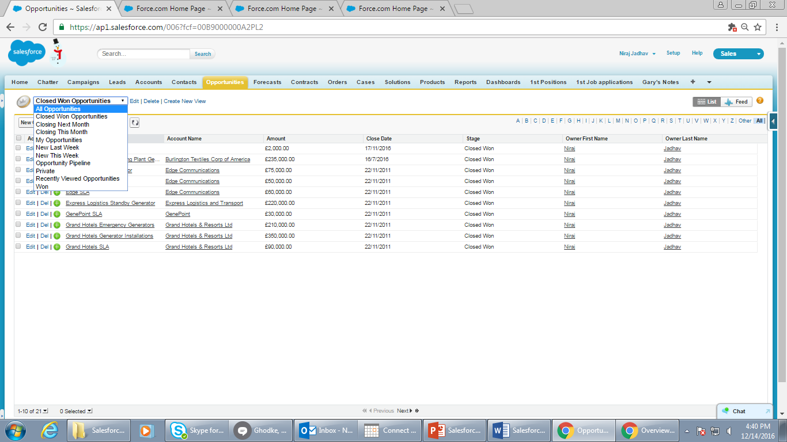
List View options

Slide 92
Exercise:-
Create few List Views in Opportunities, Contact, Account, & Custom Object.

Slide 93
Custom Button
Every detail page includes several Standard Buttons, including Edit, Delete, Clone, etc. You can also create custom buttons and add them to page layouts as needed. Custom Button are used to create new record, certain records with auto populated values, certain logics on clicking on button, etc.
Salesforce Help:- https://help.salesforce.com/articleView?id=customize_enterprise.htm&type=0&language=en_US&release=204.17
YouTube:- https://www.youtube.com/watch?v=BtpUnNklgZc

Slide 94
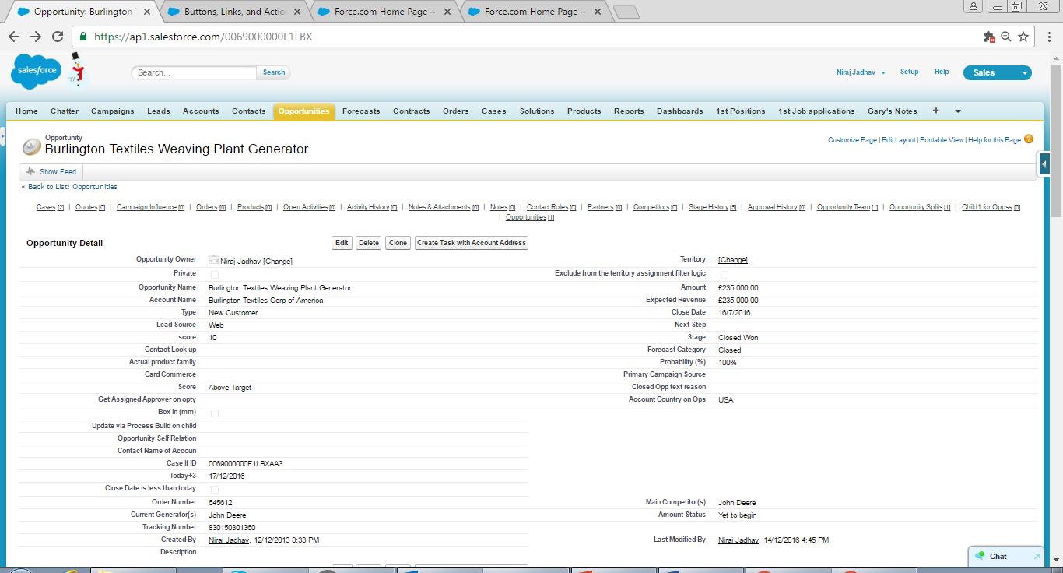
Custom Button

Slide 95
Exercise:-
Create new Custom Button to display Account Industry field in some text custom field on Contact Object.

Slide 96
Custom links
Custom Links are used to provide quick access to relevant or frequently-used Salesforce pages, such as search Account/Contact Name in Google , Sales by Rep report, Opportunity Report,, etc. Custom links are hyperlinks that can include Salesforce fields as tokens within a URL or on Visualforce pages.
Salesforce Help:- https://help.salesforce.com/articleView?id=defining_custom_links.htm&language=en_US&r=https%3A%2F%2Fwww.google.co.in%2F&type=0
YouTube:- https://www.youtube.com/watch?v=Xd30crFI36c

Slide 97
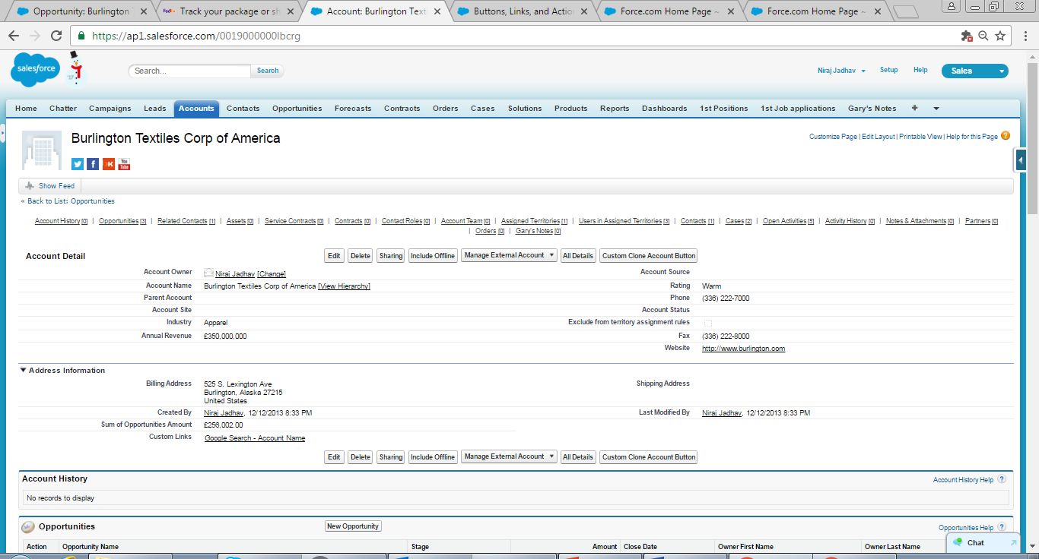
Custom Link

Slide 98
Exercise:-
Create new Custom Link to display particular page of Salesforce or Report.

Slide 99
Queues
Queues help your teams manage Leads, Cases, Service Contracts, and Custom Objects. Once records are placed in a queue manually or through an automatic case or lead assignment rule, records remain there until they're assigned to a user or taken by one of the queue members.
Salesforce Help:- https://help.salesforce.com/articleView?id=queues_overview.htm&language=en_US&type=0
YouTube:- https://www.youtube.com/watch?v=JSIJwxLV2Zw

Slide 100
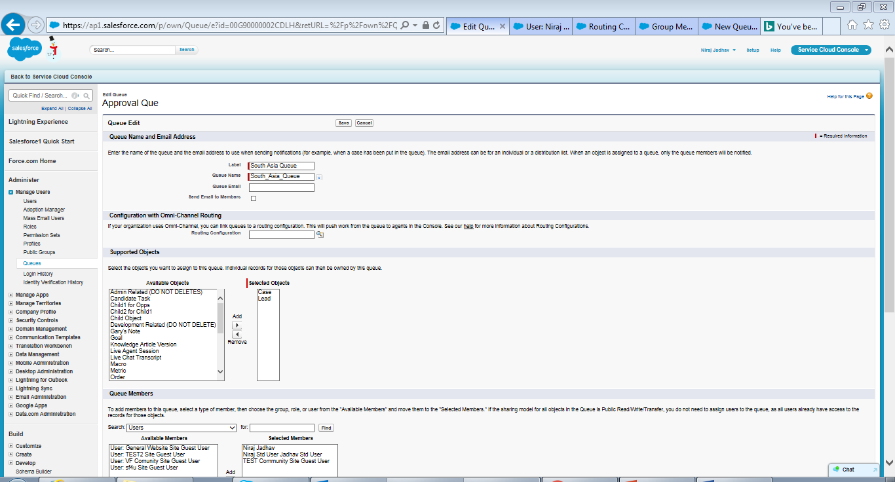

Slide 101
Exercise:-
Create 2 Queues and assign certain users to it.

Slide 102
Public Group
Public group is group of related users, other groups or role/territory, who will share the data within that group.
Salesforce Help:- https://help.salesforce.com/articleView?id=user_groups.htm&language=en&type=0
YouTube:- https://www.youtube.com/watch?v=JjyxGL7bXBo

Slide 103
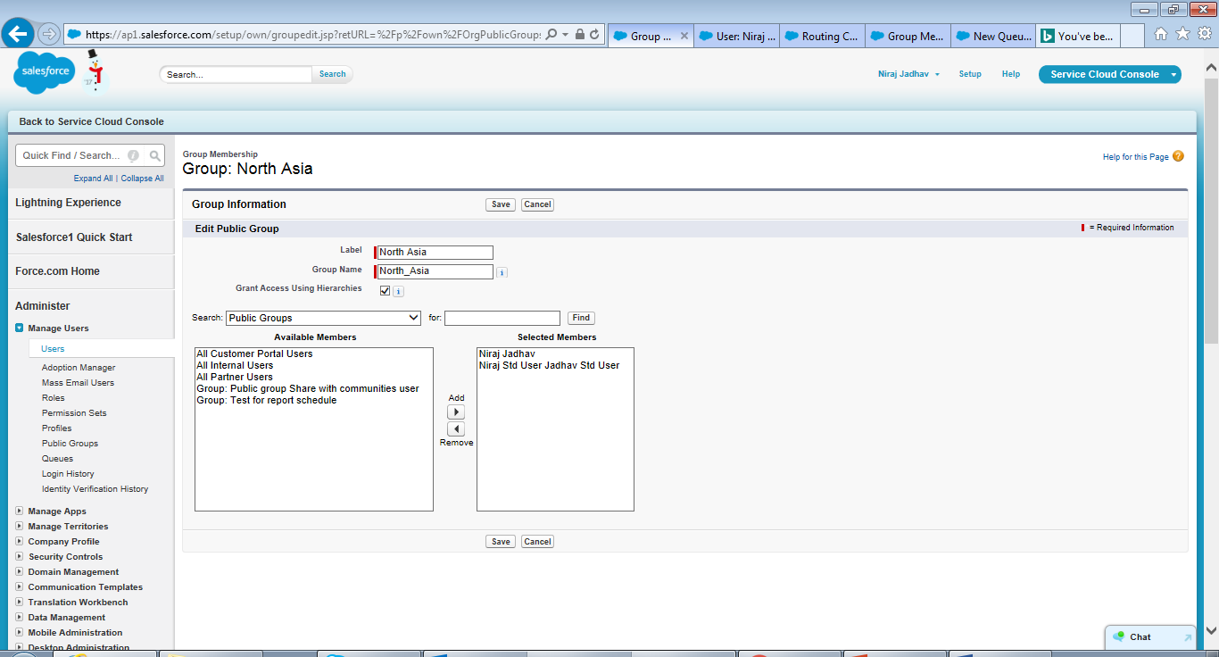

Slide 104
Exercise:-
Create 2 Public Group and add some users in it.

Slide 105
Sharing Settings
Sharing rules represent automatic exceptions to your Organization-Wide Default settings. If you have Organization-Wide Sharing defaults of Public Read Only or Private, you can define rules to Public Groups, Queues, Roles, & Roles and Sub-ordinates that give more users access to records they do not own.
Salesforce Help:- https://help.salesforce.com/articleView?id=security_about_sharing_rules.htm&language=en&type=0
YouTube:- https://www.youtube.com/watch?v=JEKZ2OjwzS8

Slide 106
Continued…
There are 2 types to Sharing:-
Sharing Rule:- In Sharing Rule, there are 2 types of Sharing Rule.
Based on Record Owner:- Records are shared with other Public Groups, Queues, Roles, & Roles and Sub-ordinates on basis of Record Owner/Owership(E.g. If Account Owner = Niraj Jadhav share with Public Group – West Zone-India.)
Based on Criteria:- Records are shared with other Public Groups, Queues, Roles, & Roles and Sub-ordinates on basis of Record Criteria(E.g. If Account Country = India share with Public Group – South Asia).
2. Manual Sharing:- A record, which shared manually post clicking “Sharing” button on record itself. We can share it to Public Groups, Roles, Roles and Sub-ordinates, & Users.

Slide 107
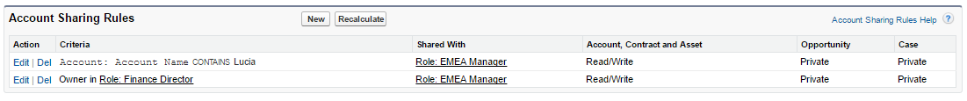
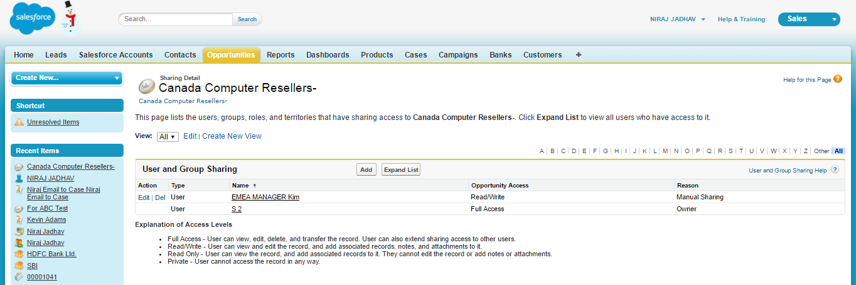
1. Sharing Rule - Based on criteria
2. Sharing Rule - Based on record owner
3. Manual Sharing

Slide 108
Exercise:-
Setup Sharing Rules 1 for Criteria Based Sharing Rule and 2 for Ownership Based Sharing Rule. Also share record manually.

Slide 109
Teams (Account Team, Opportunity Team, & Case Team)
A Group of Salesforce users who work together on a Account/Opportunity/Case object and share record irrespective to Role Hierarchy or Organization Wide Defaults.
Salesforce Help- Account Team:- https://help.salesforce.com/articleView?id=accountteam_def.htm&type=0&language=en_US&release=204.17
Salesforce Help- Opportunity Team:- https://help.salesforce.com/articleView?id=salesteam_overview.htm&type=0&language=en_US&release=204.17
Salesforce Help- Case Team:- https://help.salesforce.com/articleView?id=caseteam_def.htm&type=0&language=en_US&release=204.17
YouTube:- https://www.youtube.com/watch?v=f5NjqD6quK4

Slide 110
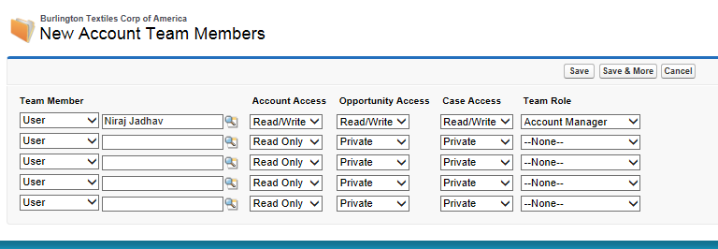
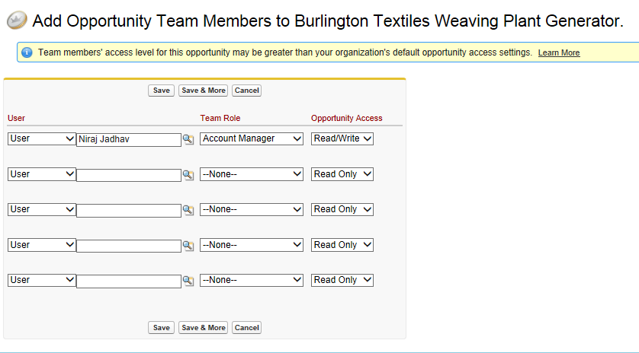

Slide 111
Exercise:-
Create 1 Account Team and 2 Opportunity Team.

Slide 112
Activity Management
Activity Management includes Tasks and Events. Following up with your clients is an important work that needs to be done carefully and precisely because in this competitive world, we do not want to miss any business due to negligence.
“Tasks” are items TO-DO items that you have assigned to yourself or that someone else has assigned to you.
Jay Gupta asked Ram to call him tomorrow anytime. Then, Ram creates Tasks for tomorrow.
Example:- Company research, Phone call to client, Send proposal etc. within due date (Example:- 2 days) of Lead creation.
“Events” are calendar items that have a Start Date / Time and End Date / Time and where you can engage more people including Customers, mangers or other Sales representatives.
Ram creates Event for “Meeting with Jay Gupta at ABC Ltd Office between 3-4 PM” or “Call discussion with Jay Gupta and his Director between 10-11 am.”
Example:- “Conference call with client between 4-5 PM” or “Document collection between 10-11 am at client location.”
Salesforce Help:- http://www.dhruvsoft.com/blog/starting-with-activity-and-task-management/
YouTube Help:- https://www.youtube.com/watch?v=4VsGZsCcw24

Slide 113
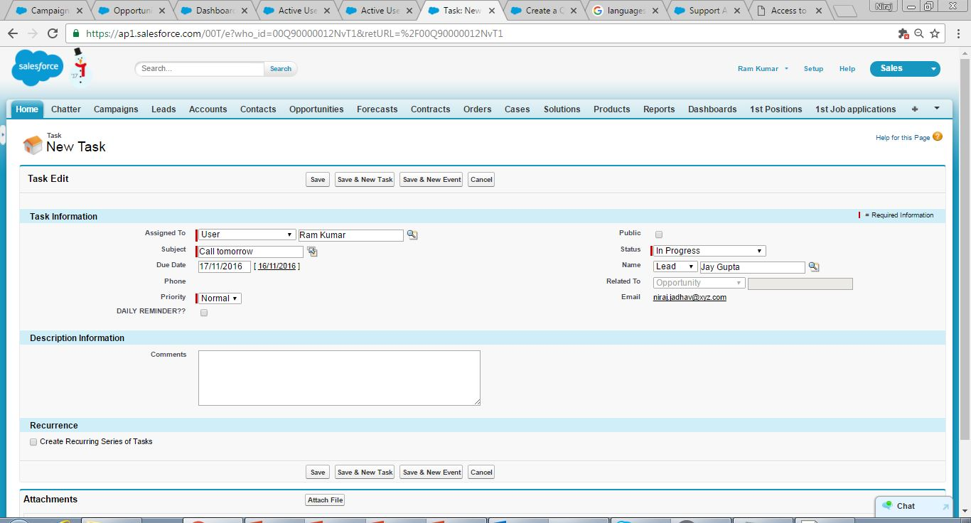
Task for follow up call tomorrow

Slide 114
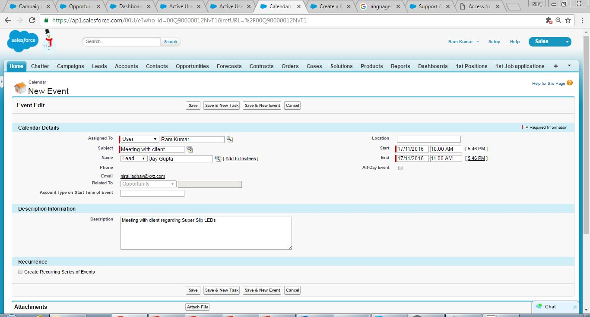
Event for Client Meeting at 10.00am till 11.00am

Slide 115
Exercise:-
Create few Tasks and Events on Contact and Custom Objects.

Slide 116
Validation Rules
Certain data needs to enter in certain formats or standards such as Email Id, Website, etc before saving records. Hence, Validation Rules is used to improve the quality of your data.
There are 2 types of Validation Rule.
i. Standard Validation Rule:- By default enforced by Salesforce upon saving record such as email, website, etc
ii. Custom Validation Rule:- We will create as per our logic to achieve business requirement.
A validation rule can contain a formula or expression that evaluates the data in one or more fields and returns a value of “True” or “False”. Validation rules also include an error message to display to the user when the rule returns a value of “True” due to an invalid value.
Salesforce Help:- https://help.salesforce.com/articleView?id=fields_about_field_validation.htm&type=0&language=en_US&release=204.17
YouTube:- https://www.youtube.com/watch?v=0ZBXE215akk

Slide 117
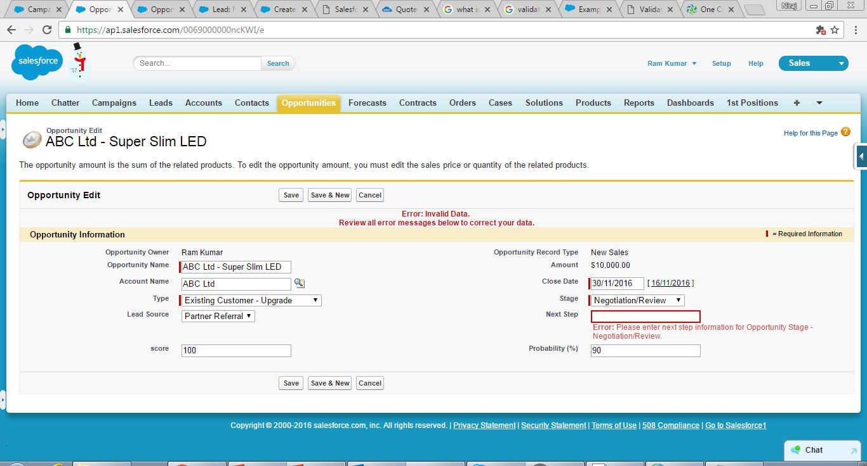
Custom Validation error enforces to enter some value in ‘Next Step’ whenever Stage = Negotiation/Review

Slide 118
Exercise:-
Create Custom Validation Rule to restrict user to change Opportunity Amount, if Opportunity Amount is not blank.
Create Custom Validation Rule where Only Sys Ad should be able to make changes in Opportunity Amount, if Opportunity Amount is not blank.

Slide 119
Workflow Rule
It is an automation tool which do certain action/s on meeting certain criteria/s. Salesforce can do a number of things, like send an email, create a task, or update a field.
There are 3 types of Evaluation Criteria by which Workflow Rule will fire.
i. Created.
ii. Created, and every time it's edited.
iii. Created, and any time it's edited to subsequently meet criteria.
We can also create Time Dependent Workflow, which will fire after/before particular time (Time dependent Workflow Rule not applicable to Created, and every time it's edited.)
Example:- Ram wants a functionality whenever ‘Opportunity Amount’ is equal to or greater than 10,000/- then ‘Opportunity Score’ field should get auto-updated with 100, just for their sales scoring purpose.
Salesforce Help:- https://help.salesforce.com/articleView?id=workflow_rules_new.htm&type=0&language=en_US&release=204.14#firstQueryMeta=%5Bobject%2520Object%5D
YouTube:- https://www.Youtube.com/watch?v=kF0_6d3Jzf4

Slide 120

As Criteria is meeting as per example, Workflow will update ‘Score’ to 100 automatically once record is saved

Slide 121

Workflow has updated field value from blank to 100 post meeting criteria (i.e. Amount >= 10,000)

Slide 122
Exercise:-
Create a New Workflow Rule on Opportunity to capture Account – Industry value in Opportunity – Description whenever Opportunity is created and edited.
Create a New Workflow Rule on Contact to send an email alert to Contact Owner whenever new contact is created.
Create a New Workflow Rule on Opportunity to send an email alert to Opportunity Owner if there is no work done on particular opportunity more than 24 hours.

Slide 123
Process Builder
Basically Process Builder is advance version of Workflow. 1) Process Builder is mainly used to avoid use of multiple Workflow because one Workflow can have only one condition and criteria action but one Process Builder can have multiple if/else condition. 2) Process builder allow you to update Child record where as Workflow does not. 3) Process Builder can call your Apex code so it can send email alerts, submit records for approvals using apex code whereas Workflow cannot call Apex but can send Email/Outbound alert only without code.
Salesforce Help:- https://help.salesforce.com/articleView?id=process_overview.htm&type=0&language=en_US&release=204.17
YouTube:- https://www.youtube.com/watch?v=WwwliJjx61M

Slide 124


Slide 125
Exercise:-
Create a Process Builder on Opportunity to update Opportunity Amount in Account Description field as “Opportunity Amount xxxx”.
Create a Process Builder to do Time Dependent similar as Workflow Time Dependent Rule on Contact.
Create a Process Builder to send an email alert whenever new Contact is created.

Slide 126
Approval Process
Approval process is an automated process where record gets Approved or Rejected on basis of Approver’s description post referring to submitted record/s. An approval process is combination of steps for a record to get submitted and person has to approve/reject it each step. A step can apply to all the records to that object or just record that meets the certain criteria for Approval Submission. Submitter may recall the record as per business requirement.
There are 2 type of Approval Process:-
1. Unanimous Approval Process:- Unanimous Checkbox refers to each person or group within the Approval Process. Then unanimous approval would require each individual person to approve before the Approval goes through, if any one Reject it, it will get Rejected.
2. First Response:- Approval Process Approved/Rejected on basis of First Response.
Salesforce Help:- https://help.salesforce.com/articleView?id=approvals_getting_started.htm&type=0&language=en_US&release=204.17
YouTube:- https://www.youtube.com/watch?v=SGG_1eR2wyE

Slide 127


Slide 128
Exercise:-
Create an Approval Process and try to recall, reject, & approve the record.

Slide 129
Reports
A report is a list of records that meet the criteria you define. Its displayed in Salesforce in rows and columns, and can be filtered, grouped, or displayed in a graphical chart.
Report can be Standard Report or Custom Report.
There are 4 types of Report.
Tabular report:- This is the most basic report. It displays just the row of records in a table like format with grand total. Tabular reports cannot be used for generating dashboards.
Summary report:- This is the most commonly type of report. It allows grouping of rows of data. It supports sorting and displaying subtotals. For example in a recruiting app, a summary report could be used to display open positions classified by department name.
Matrix report:- This is the most complex report format. Matrix report summarize information in a grid format. Matrix reports allows records to be grouped by both columns and rows. Summary and Matrix reports can be used to generate dashboards.
Joined Report:- Joined reports let you create different views of data from multiple report types. In a joined report, data is organized in blocks.
Salesforce Help:- https://help.salesforce.com/articleView?id=reports_builder_editing.htm&type=0&language=en_US
Youtube1:- https://www.Youtube.com/watch?v=VBXeMgX6ZtE
Youtube3:- https://www.Youtube.com/watch?v=broc6ylpeAc

Slide 130



Summary Report
Matrix Report
Joined Report

Slide 131
Exercise:-
Create Summary Report on Account & Contact information.
Create Matrix Report on Opportunity for month wise information.
Create Table Report on Cases.

Slide 132
Bucket Fields
Bucket fields helps you to quickly group report records without creating a formula or a custom field on object. Bucket field is only available in Summary Report & Matrix Report.
You can bucket fields, which have data types of 1. Picklist, 2. Number, etc. For example, you want to group by Amount/Quantity into ranges. To do this, create a bucket field on Amount/Quantity and define the ranges. We can also do bucket fields on Picklist field.
Salesforce Help:- https://help.salesforce.com/articleView?id=reports_bucketing_adding.htm&type=0&language=en_US&release=204.17
YouTube:- https://www.youtube.com/watch?v=Dq1TkYzT-mM

Slide 133

Bucket Fields

Slide 134
Exercise:-
Create bucket field on Product Quantity.
Create bucket field on Lead Status.
Can we create bucket field on Account Name? If not, why would be the reason.

Slide 135
Custom Report Types
Custom report types created and added by an administrator. Within a custom report type, you can specify which objects and fields are included in the report. When creating a custom report type, pay very close attention to the two options when selecting relationships (Each “A” record [must / may or may not] have at least one “B” record). The objects and relationships selected determine which records will be included when reports of this type are run.
Salesforce Help:- https://help.salesforce.com/articleView?id=reports_defining_report_types.htm&type=0&language=en_US&release=204.17
YouTube:- https://www.youtube.com/watch?v=cgCDsXoY46s

Slide 136


Slide 137
Exercise:-
Create 2 custom report type.

Slide 138
Report Scheduling
We can schedule reports to run and have the results automatically emailed in HTML format to Salesforce users.
Scheduling a report does three things:
• Get the latest report data without having to run the report.
• Schedule a report to run automatically at regular intervals. You can schedule a report daily, weekly, or monthly.
• Email report results in HTML format.
Salesforce Help:- https://help.salesforce.com/articleView?id=reports_schedule_overview.htm&type=0&language=en_US&release=204.17
YouTube:- https://www.youtube.com/watch?v=Vl8Tme5bZsQ

Slide 139


Slide 140
Exercise:-
Create a report and schedule it for daily at 10.00pm, if option is not available then kindly explain the same.

Slide 141
Dashboards
Dashboards are graphical representation of reports. Dashboards can be generated for summary or matrix reports (and not for tabular reports). Dashboards display data as per last time report was run. The relationship between a dashboard component and report is 1:1. A dashboard can have up to 20 components.
Type of Dashboard Components:
1. Horizontal Bar Chart 2. Vertical Bar Chart
3. Line Chart 4. Pie Chart
5. Donut Chart 6. Funnel Chart
7. Scatter Chart 8. Gauge
9. Metric 10. Table
Visualforce Page
Salesforce Help:- https://developer.salesforce.com/docs/atlas.en-us.204.0.fundamentals.meta/fundamentals/adg_reports_dashboards.htm
YouTube:- https://www.Youtube.com/watch?v=URe5YgTIPv8

Slide 142
Continued…
There are 2 types of “Run as” option in Dashboard.
1. Run as specified user:- Dashboard will display information on basis of Specified User. (E.g. Dashboard is set as “Run as specified user” as System Admin Profile – User A and Standard User Profile – User X is accessing Dashboard then Dashboard will display information on basis of run as specified user, which is System Admin Profile – User A.)
2. Run as logged-in user (Dynamic Dashboard):- Dashboard will display information on basis of logged-in user. (E.g. Dashboard is created by System Admin, however, it is “Run as logged-in user” and Standard User Profile – User X is accessing Dashboard then Dashboard will display those information on basis of Standard User profile can access.)

Slide 143


Slide 144
Exercise:-
New Dashboard, which will include Account & Contact, Opportunity, & Cases information.

Slide 145
Report/Dashboard Folder Sharing
Reports and Dashboards are shared through folders. You share the folder, not the Report or Dashboard itself. To let others work with your Report or Dashboard, give them Viewer, Editor or Manager access to the folder where the Report or Dashboard is stored. When Report/Dashboard sharing is in effect, all users in the organization get Viewer access by default to Report and Dashboard folders that are shared with them. Users can edit and modify Report/Dashboard where they are Managers or Editors on a given folder.
Salesforce Help:- https://help.salesforce.com/articleView?id=analytics_share_folder.htm&type=0&language=en_US&release=204.17
YouTube:- https://www.youtube.com/watch?v=Jxz8Q4drihk

Slide 146


Slide 147
Exercise:-
Create few Report Folder and Dashboard Folder then set level of sharing permission as per your need.

Slide 148
Communities
A - Community is a powerful tool built on Force.com Platform.
B - Using Communities you can engage your Customers as your Business Partners where they can work with you in Selling Activities.
C - Partners can login to Partner Community and Create a Lead in Salesforce where he will work towards converting it to an Account.
Example:- Dheeraj Bhatt is very happy with the Super Slim LEDs and services offered to ABC Ltd. He finds out that one of his Social Contact is also looking for Super Slim LEDs. In this Case Dheeraj can login to ‘Salesforce Partner Community’ and create a Lead for Ram. Thus, Dheeraj becomes Ram's partner as he is helping him to grow his business.
Salesforce Help:- https://help.salesforce.com/articleView?id=networks_overview.htm&type=0&language=en_US&release=204.14
YouTube:- https://www.Youtube.com/watch?v=sfSMcz_H4ak

Slide 149

Dheeraj logs in as Partner User in Partner Community
The Partner User (Contact – Dheeraj Bhatt) can create Leads, Opportunities and Accounts

Slide 150
Community Management
Community Management is a configuration page where Members, Tab, Access, Permissions, etc. defined by System Administrator.
Example:- Ram can define security for Partner Community - Dheeraj Bhatt so that no business specific or other sensitive data is shared.
Salesforce Help:- https://help.salesforce.com/articleView?id=networks_overview.htm&type=0&language=en_US&release=204.14
YouTube:- https://www.Youtube.com/watch?v=sfSMcz_H4ak

Slide 151

Configuring Community Management

Slide 152
Answers
Answers or Chatter Answers is a self-service support community where users can post questions and receive answers and comments from other users or your support agents. Community members can then vote on the helpfulness of each reply, and the person who asked the question can mark one reply as the best answer.
Salesforce Help:- https://help.salesforce.com/articleView?id=answers_overview.htm&type=0&language=en_US&release=204.17
YouTube:- https://www.youtube.com/watch?v=U0fnd99iEgo

Slide 153


Slide 154
Exercise:-
Create some Answers with help of Communities Portals

Slide 156
Ideas
Ideas is a community of users who post, vote for, and comment on ideas. An Ideas community provides an online, transparent way for you to attract, manage, and showcase innovation.
There are 3 necessary steps to set up and use Ideas.
• Ideas Preparation:-
It decides who should access Ideas and the type of community you want to create for your users.
• Ideas Setup:-
To configure Ideas to meet the needs of your organization.
• Ideas Administration:-
To Perform a few ongoing administration tasks to keep community members engaged.
Salesforce Help:- https://help.salesforce.com/articleView?id=ideas_about.htm&type=0&language=en_US&release=204.17
YouTube:- https://www.youtube.com/watch?v=QChazhxDbq8

Slide 157

Idea

Slide 158
Exercise:-
Create 2 Ideas and vote – comment on it.

Slide 159
Multi Currency
International organizations can use multiple currencies in Opportunities, Reports, Quotes, etc. currency fields.
It adds the ability to record amounts in different currencies. If the org don’t have multicurrency enabled, then amounts are just displayed as a number.
It allows amounts to be converted, displayed and reported according to manually entered exchange rates.
It also allows the use of manually entered dated exchange rates so the value at a certain time can be fixed.
Opportunities can be entered in multiple currencies.
Products can be priced in different currencies.
Reporting and forecasting can be done in record currency and corporate currency. ‘Converted’ fields are added and available for reporting.
Salesforce Help:- https://help.salesforce.com/articleView?id=admin_enable_multicurrency_implications.htm&type=0&language=en_US&release=204.14#firstQueryMeta=%5Bobject%2520Object%5D

Slide 160
Additional Information on Multiple Currencies.
Once enabled, multiple currencies can’t be disabled.
The enablement process temporarily locks your organization, preventing any integration processing and user logins.
One has to raise a case to request the Multicurrency enablement.
Upon enablement, all existing records are stamped with a default currency code that one provides in his enablement request.
A currency field is added to standard and custom objects.
After enablement, all currency fields display the ISO code of the currency before the amount. For example, $100 displays as USD 100.
By default, all converted amounts in your organization rely on the current conversion rates defined for your organization. Conversion rates must be set and updated manually.

Slide 161

Active Multi – Currencies

Slide 162

Information of Dated Exchange Rates

Slide 163

Configuring Dated Exchange Rates

Slide 164
Multi Language
Language Salesforce offers three levels of language support:
Fully Supported Languages.
End-User Languages.
Platform-Only Languages.
Each language is identified by a two-character language code, such as_EN , or a five-character locale code, such as en_AU.
Language controls the labels and translations which will be presented to the user; whereas, Locale controls things like date formats, time, and name display. Note:- Picklists change according to the current user’s selected language.
Salesforce Help:- https://help.salesforce.com/articleView?id=faq_getstart_what_languages_does.htm&type=0&language=en_US&release=204.14#firstQueryMeta=%5Bobject%2520Object%5D

Slide 165


Japanese User in Japanese Language
French User in French Language

Slide 166
Assignment Rules
Assignment rules are used to automate your organization’s Lead generation and support processes (case management).
Lead Assignment Rules – It is used to assign Leads to particular users or queues upon creation and/or meeting criteria to check whether Leads are created manually, captured from the web, or imported via the lead import wizards, etc
Case Assignment Rules – It is used to assign Cases to particular users or put into queues upon creation and/or meeting criteria to check whether Case are created manually, using Web-to-Case, Email-to-Case, On-Demand Email-to-Case, the Self-Service portal, the Customer Portal, Outlook, etc.
Salesforce Help:-
https://help.salesforce.com/articleView?id=creating_assignment_rules.htm&type=0&language=en_US&release=204.17
YouTube:- https://www.youtube.com/watch?v=9Qus4sWNqkw

Slide 167


Lead Assignment Rule
Case Assignment Rule

Slide 168
Exercise:-
Create 2 Assignment Rules on Cases and Leads.
Try to create Assignment Rule on Custom Object. If not, then what would be possible workaround.

Slide 169
Auto-Response Rules
Send automatic email responses to Lead or Case submissions based on the record’s attributes. Set up Auto-Response Rules to send quick replies to customers to let them know someone at your company received their inquiry or details about their issue/concern.
Create auto-response rules for below mentioned functions:-
Leads captured from Web-To-Lead.
Self-Service portal.
Customer Portal.
Web-to-Case form.
Email-to-Case message, etc.
Salesforce Help:- https://help.salesforce.com/articleView?id=creating_auto-response_rules.htm&language=sv_1__3&type=0
YouTube:- https://www.youtube.com/watch?v=_UlzvvE5j5A

Slide 170


Lead Auto Response
Case Auto Response

Slide 171
Exercise:-
Create 2 Auto Response Rules on Cases and Leads.
Try to create Assignment Rule on Custom Object, if not, then what would be possible workaround.

Slide 172
Escalation Rules
It is used on a case that needs to be escalated after a predefined time if it meets certain criteria where you may notify a manager and flagging the case.
Salesforce Help:- https://help.salesforce.com/articleView?id=rules_escalation_create.htm&type=0&language=en_US&release=204.17
YouTube:- https://www.youtube.com/watch?v=OzYjj5vJyk4

Slide 173

Escalation Rule

Slide 174
Exercise:-
Create 2 Escalation Rules on Cases.
Try to create Escalation Rule apart from Cases, if not, then what would be possible workaround.

Slide 175
Knowledge
Salesforce Knowledge is a knowledge base for creating and managing content. If Salesforce Knowledge is enabled in the Customer Portal or partner portal, customers and partners can access articles. Details for Performance, Unlimited, Enterprise, and Developer Editions.
To access knowledge, Knowledge User checkbox should be checked on User details page.
Salesforce Help:- Differences Between Files, Salesforce CRM Content, Salesforce Knowledge, Documents, and Attachments.
https://help.salesforce.com/articleView?id=knowledge_whatis.htm&language=th&type=0
Salesforce Help:-
https://help.salesforce.com/articleView?id=collab_files_differences.htm&language=en&type=0
YouTube:- https://www.youtube.com/watch?v=H0OyCkP8GTA

Slide 176

Content/Knowledge

Slide 177
Exercise:-
Create some articles and display it on Cases.

Slide 178
Data Loader
The Data Loader is an easy to use graphical tool that helps you to get your data out or into Salesforce objects. You can even use the Data Loader to perform bulk deletions by exporting the ID fields for the data you wish to delete and using that source to specify deletions through the Data Loader.
When importing data, Data Loader reads, extracts, and loads data from comma-separated values (CSV) files or from a database connection. When exporting data, it outputs CSV files.
To install Data Loader.exe file click on Setup | Data Management | Data Loader.
Salesforce Help:- https://developer.salesforce.com/docs/atlas.en-us.202.0.dataLoader.meta/dataLoader/data_loader.htm
YouTube:- https://www.youtube.com/watch?v=X7zTs5Hxe6k

Slide 179


Slide 180
Exercise:-
Create New CSV file to Import New Accounts & Contacts.
Export All Accounts & Contact and then update particular custom field in CSV file.

Slide 181
Data Import Wizard
Data import wizard provides you to load the data into Salesforce. By using this wizard we can Insert, Update & Upsert the records. We can load/import up to 50000 records. I won't allow you to load duplicate records. We can only load Accounts, Contact, Leads, Solution, Custom Object, and Campaign Members.
To open Data Import Wizard click on Setup | Data Management | Data Import Wizard and click to Launch Wizard.
Salesforce Help:- https://help.salesforce.com/articleView?id=data_import_wizard.htm&type=0
YouTube:- https://www.youtube.com/watch?v=qIiWVz8EA74

Slide 182


Slide 183
Exercise:-
Import Account via CSV file.
Would you be able to update User last name with help of Data Import Wizard? If not, why?

Slide 184
Data Export
Data Export lets you prepare a copy of all your data in salesforce.com. You can start the export process manually or schedule it to run automatically. When an export is ready for download you will receive an email containing a link that allows you to download the file(s). The export files are also available on this page for 48 hours, after which time they are deleted.
Salesforce Help:- https://help.salesforce.com/articleView?id=admin_exportdata.htm&siteLang=en_US&type=0
YouTube:- https://www.youtube.com/watch?v=2XCTHf3dP0Y

Slide 185


Slide 186
Exercise:-
Schedule Data Export for All Object and have a look at file.

Slide 187
Compare - Data Loader, Data Import Wizard, & Data Export.
Data Import Wizard | Data Loader | Data Export
1. Is designed for less-technical users and smaller, simple imports of up to 50,000 records﻿. 2. Can only import data of : Account , Contact ,Leads , Solution, Campaign Members and Custom Object. | 1. It is used for complex Imports/Export/Delete/Upsert up to 5 million records. 2. It can upload more than 50000 records. 3. Can import data of any object except User. | 1. We can only export data from this function. 2. We get 2 features of Data Export. viz. 1. Export Now & 2. Schedule Export.

